Slide 1



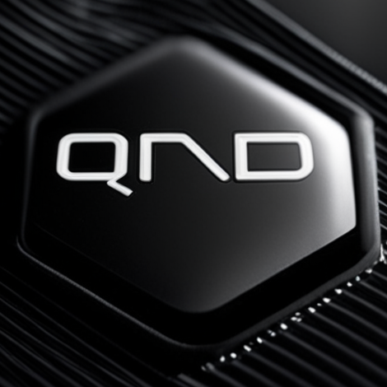

Q-Day: How Quantum Computing Will Break Today’s Modern Cryptography
(And What to Do About It)
Quantum Network Design GmbH
Alexander Pirker, PhD
May 13, 2025 – Online Webinar

Slide 2
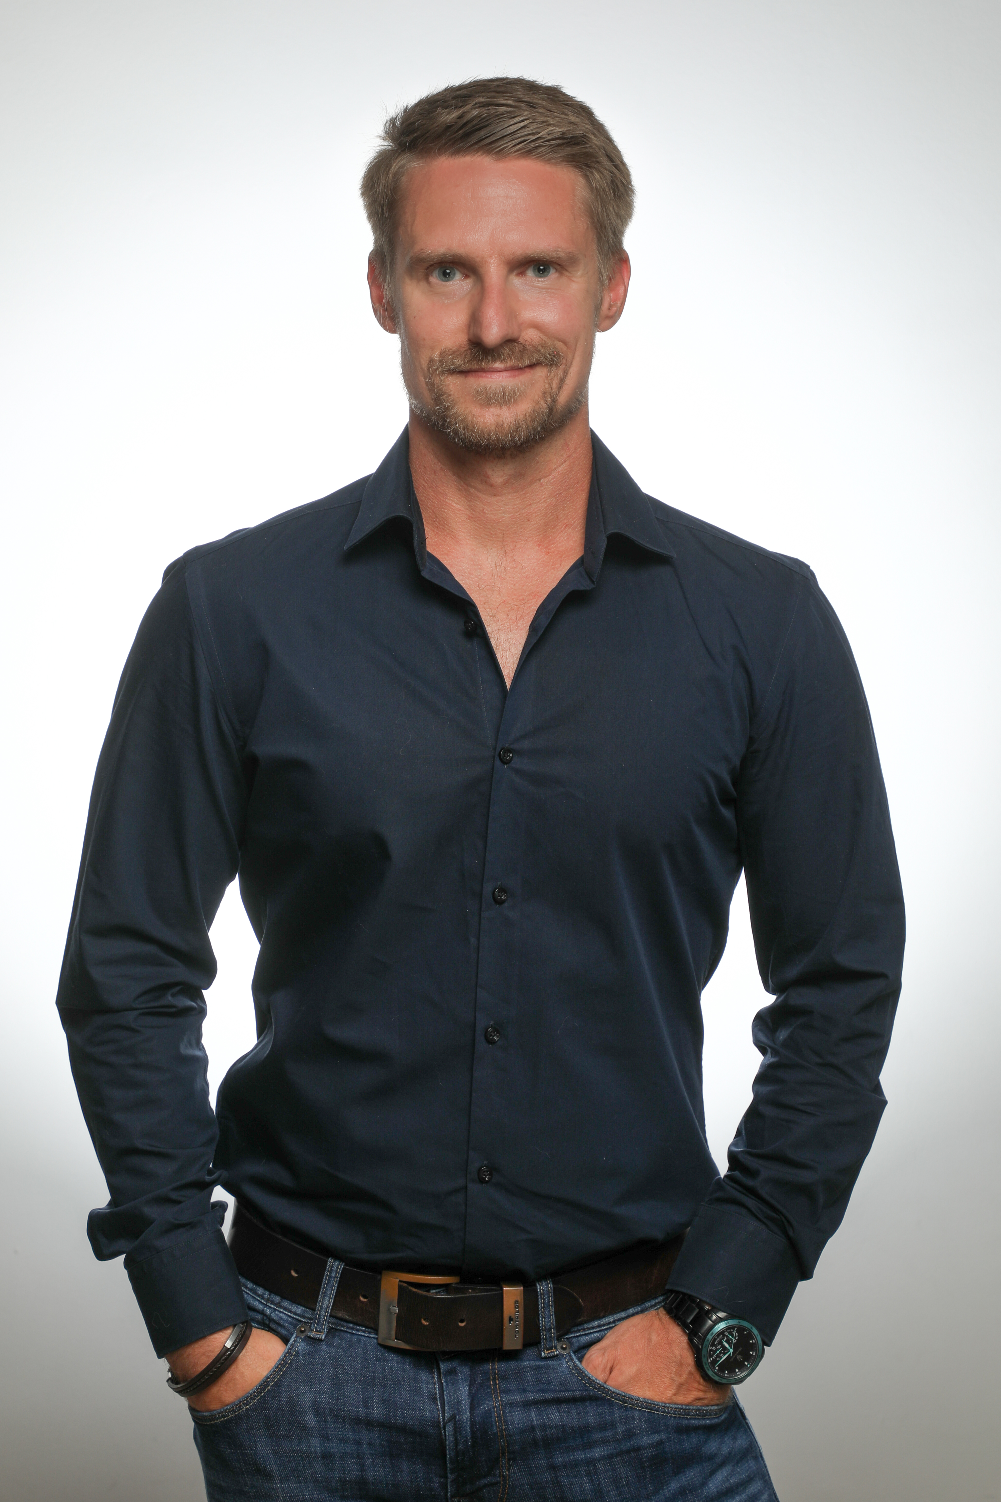
About Alex
Quantum Network Design GmbH
Master’s degree in Biomedical Informatics & Technical Mathematics
PhD degree in Physics, specialized in Quantum Physics
Co-founder and CEO at Quantum Network Design
Independent Senior Security Consultant
alexander.pirker@qnetworkdesign.com
apirker.consultant@gmail.com

Slide 3
Let’s start by having a look at qubits …
Quantum Network Design GmbH

Slide 4
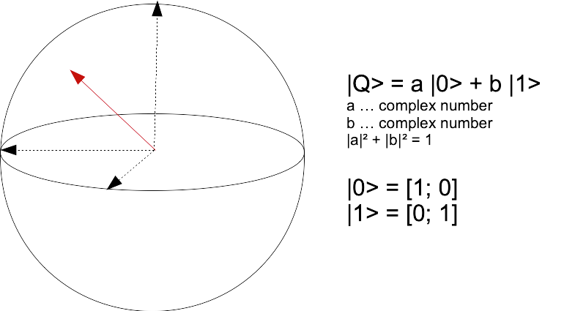
What is a qubit in a ”pure” state?
Quantum Network Design GmbH
A qubit in a pure state is a vector in a two dimensional vector space. The coefficients correspond to complex numbers, and their absolute values squared sum-up to 1.

Slide 5
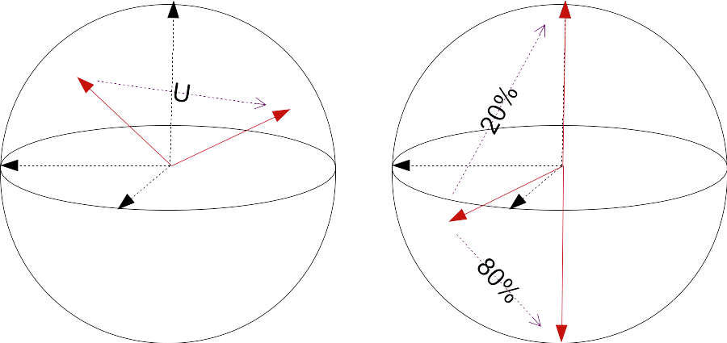
What can we do with a qubit?
Quantum Network Design GmbH
It’s all about linear transformations …
“Gates” corresponds to mulitplying the state with a matrice (unitaries), and more generally applying linear operators (CPTP maps).
“Measuring” corresponds to revealing and collapsing the state of a qubit probabilistically (projective measurements, POVM).

Slide 6
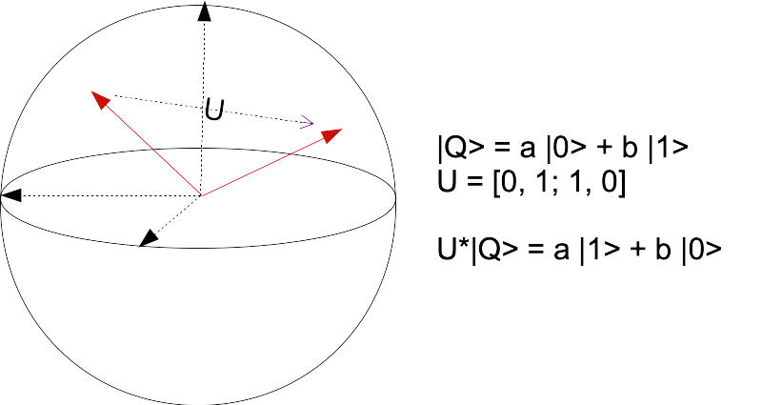
A simple example …
Quantum Network Design GmbH
Like a classical NOT that inverts a bit:
|0> --------> |1>
|1> --------> |0>

Slide 7
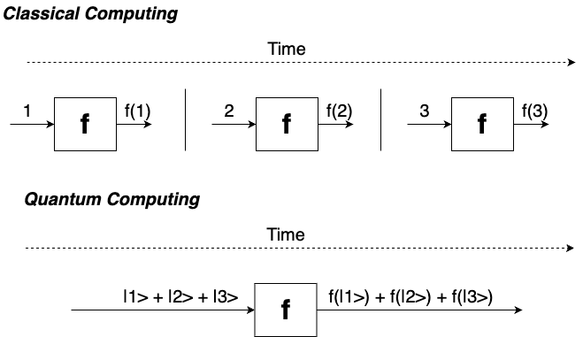
What makes quantum computers so powerful?
Quantum Network Design GmbH
Qubits can be in a superposition, which means they take several values at the same time.

Slide 8
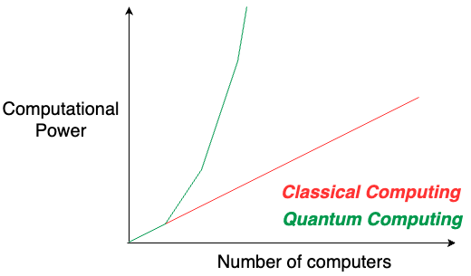
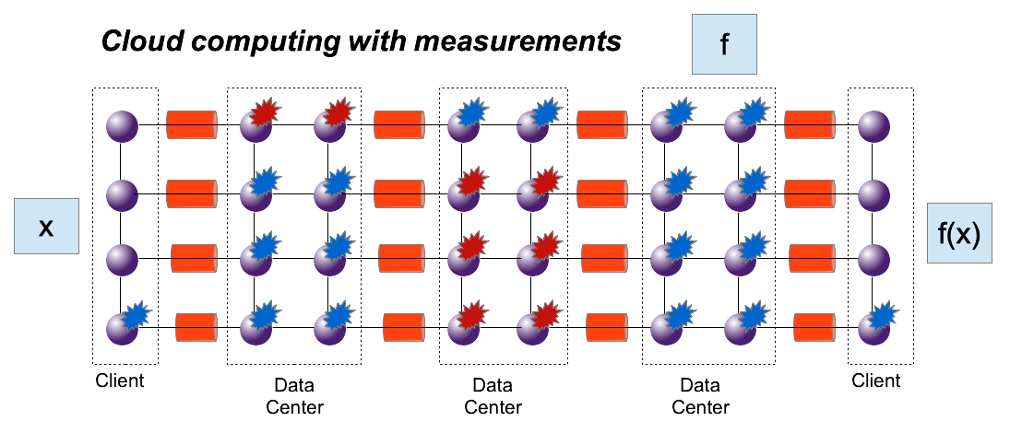
What makes quantum computers so powerful?
Quantum Network Design GmbH
Connecting quantum computers in terms of entanglement scales the problem solving capabilities exponentially, and not linearly!

Slide 9
Applications of quantum information processing
Quantum Network Design GmbH
Security:
  Secure key exchanges (QKD for TLS, calls, Meetings)
    Quantum key distribution
    Quantum key agreement
  Secure quantum channels
  Secure secret sharing
  Integer factorization using Shor
  Solving discrete logarithm problems using Shor
Sensors:
  Networks of sensors through entanglement
Clocks:
  Synchronizing clocks through entanglement
Chemistry and biology:
  Use principles of quantum mechanics for modelling molecules

Slide 10
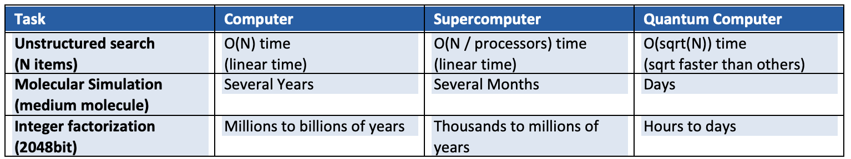
What makes quantum computers so powerful?
Quantum Network Design GmbH
The table compares some tasks or applications running on different platforms: desktop computer, supercomputer, quantum computer. It is obvious that for all of these applications the quantum computer outperforms classical computing platforms.

Slide 11
What about security?
Quantum Network Design GmbH

Slide 12
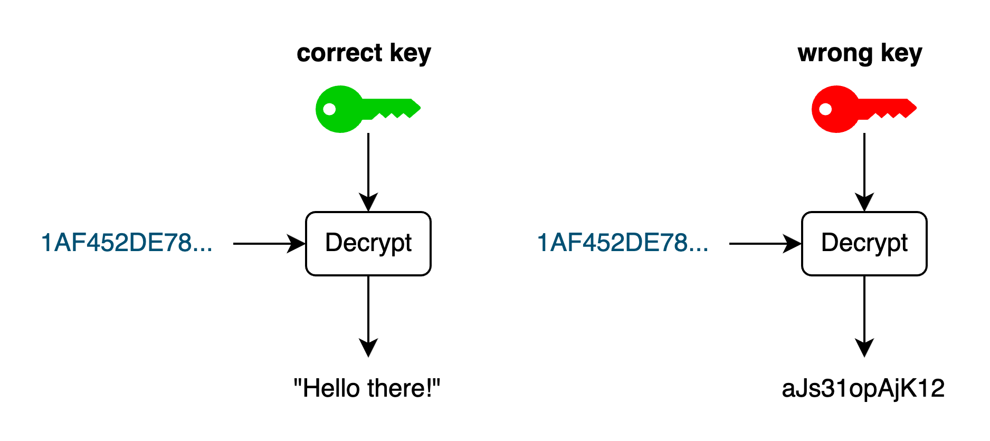
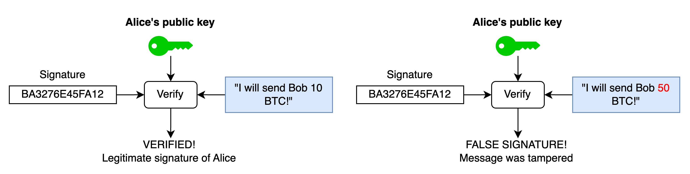
What is cryptography?
Quantum Network Design GmbH
Cryptography is an umbrella term for algorithms that aid security. By security here we usually refer to confidentiality, integrity and authenticity.
Confidentiality ensures that only the intended receiver can see the plaintext message protected by the encryption function. All other ones will see random information.
Authenticity ensures that the receiver of a message can verify that the message was sent by sender and that the message’s content was not tampered with during transmission.

Slide 13
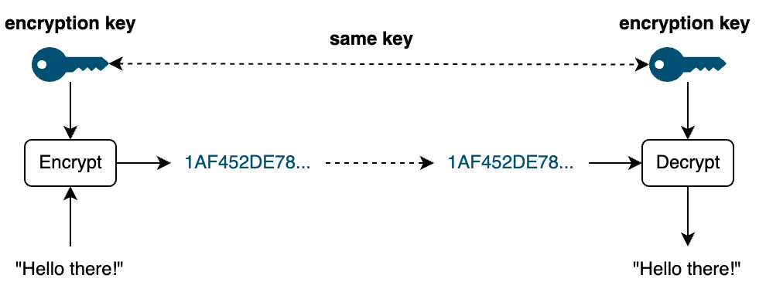
Symmetric encryption
Quantum Network Design GmbH
One party encrypts information (e.g. a message) using a cryptographic key. The other party decrypts the message using the same key.

Slide 14
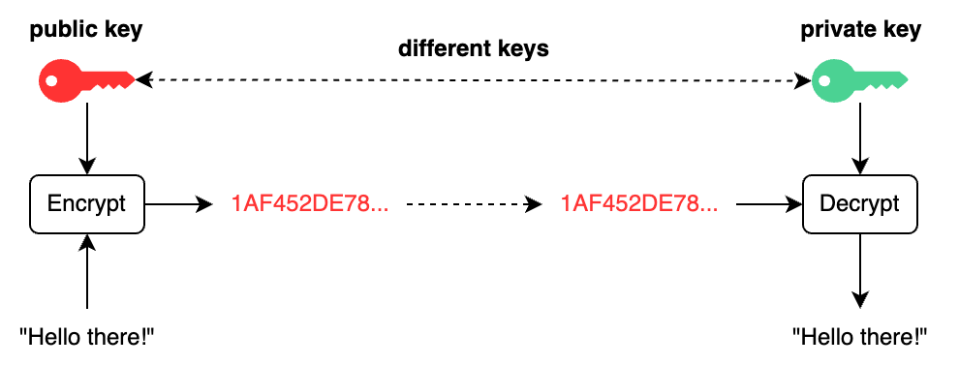
Asymmetric encryption
Quantum Network Design GmbH
One party encrypts information (e.g. a message) with the public key. The other party decrypts the message using the correspodning private key.

Slide 15
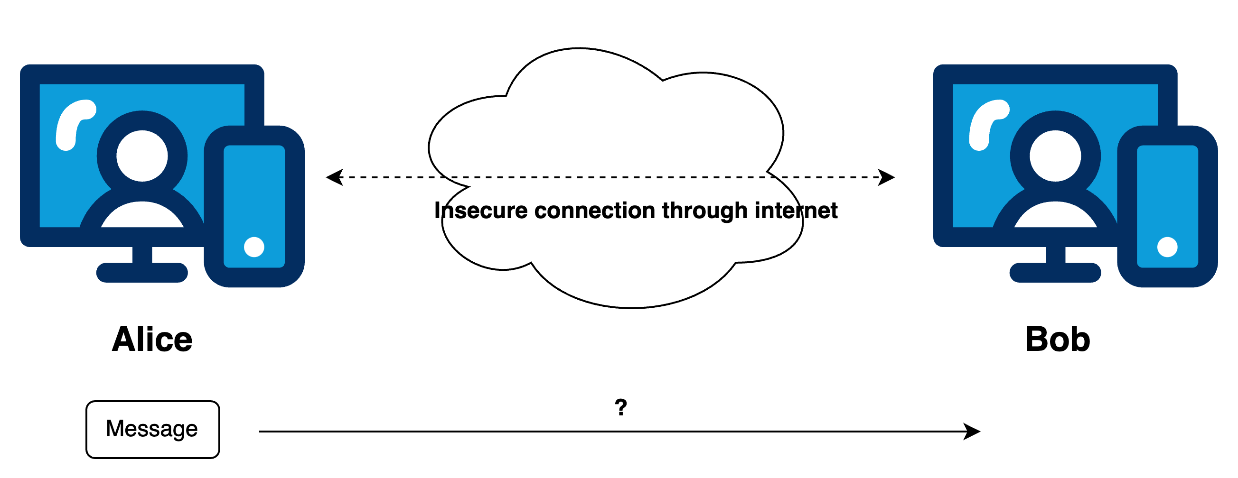
Key exchanges
Quantum Network Design GmbH
Usual communication scenario in classical networks:
Communication of confidential information over insecure internet: How to accomplish?

Slide 16
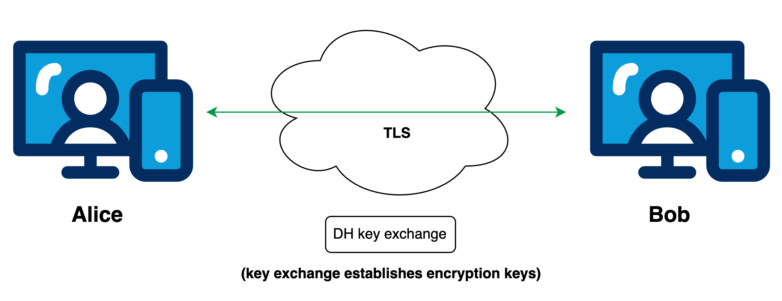
Key exchanges
Quantum Network Design GmbH
Usual communication scenario in classical networks:
Modern communication protocols such as TLS use DH to establish encryption secrets
→
Security relies on information theoretic hard problems
(breaking e.g. discrete log problem)

Slide 17
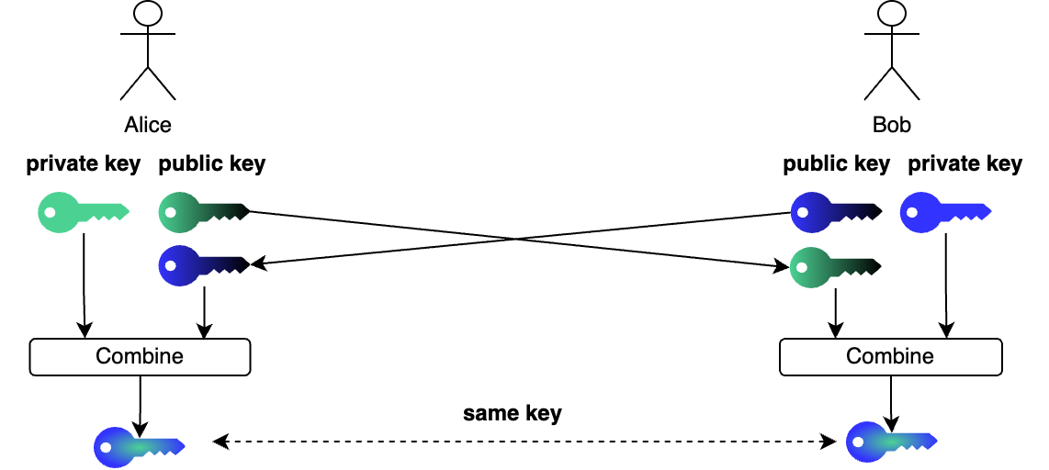
Key exchanges – How do they work?
Quantum Network Design GmbH
Two parties combine their respective private keys with the public key of the other party to arrive at a shared secret.

Slide 18
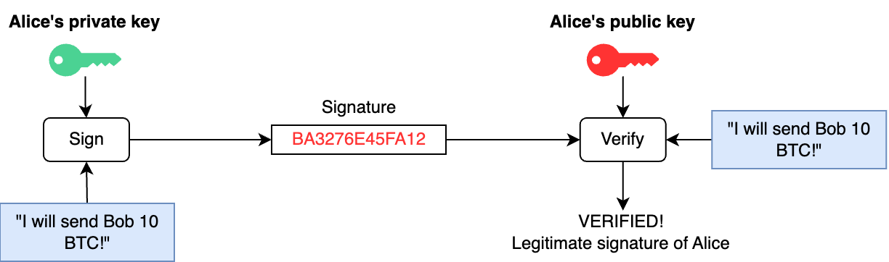
Digital signatures
Quantum Network Design GmbH
A party signs a message using its private key, and everyone else verifies the signature using the corresponding public key.

Slide 19
How does a quantum computer break modern cryptography?
Quantum Network Design GmbH

Slide 20
RSA – Foundations
Quantum Network Design GmbH
Key generation:
Choose two large prime numbers p and q
Calculate n = p*q
Compute l = lcm(p-1, q-1)
Choose 1 < e < l with gcd(e,l) = 1 (often set to 65 537)
Compute d = e⁻¹ mod l
Public key = (n, e)
Private key = d (together with p, q and l)

Slide 21
RSA – Foundations
Quantum Network Design GmbH
Example:
p = 61, q = 53
n = p*q = 3233
l = lcm(p-1, q-1) = 780
e = 17
d = e⁻¹ mod l = 413
Public key = (3233, 17)
Private key = 413 (p = 61, q = 53 and l = 780)

Slide 22
RSA – Foundations
Quantum Network Design GmbH
Encryption and decryption reverse each other under the correct key pair.
Encryption:
C = m^{e} mod n
Decryption:
C^{d} mod n = m^{ed} mod n = m

Slide 23
RSA – Foundations
Quantum Network Design GmbH
Public key = (3233, 17)
Private key = 413 (p = 61, q = 53 and l = 780)
Let m be the message 65. Then:
Encryption: C = 65¹⁷ mod 3233 = 2790
Decryption: C⁴¹³ mod 3233 = 2790⁴¹³ mod 3233 = 65

Slide 24
RSA – What is the security relying on?
Quantum Network Design GmbH
The security stems from the fact that it is hard to determine p and q from just knowing n!!!
If we were to know p and q we compute:
l = lcm(p-1, q-1)
And from there:
d = e⁻¹ mod l
Now we know the private key and can decrypt any encrypted message C:
C^{d} mod n = m^{ed} mod n = m

Slide 25
RSA – What is the security relying on?
Quantum Network Design GmbH
How would you factorize the number 3233 to find p and q?
3233:2 = 1616,5
3233:3 = 1077,666…
3233:4 = 808,25
3233:5 = 646,5
…
Just trial-and-error is not leading to any result soon, and the best known classical algorithms have (sub)exponential runtime. At some point, however, you find:
3233 : 53 = 61

Slide 26
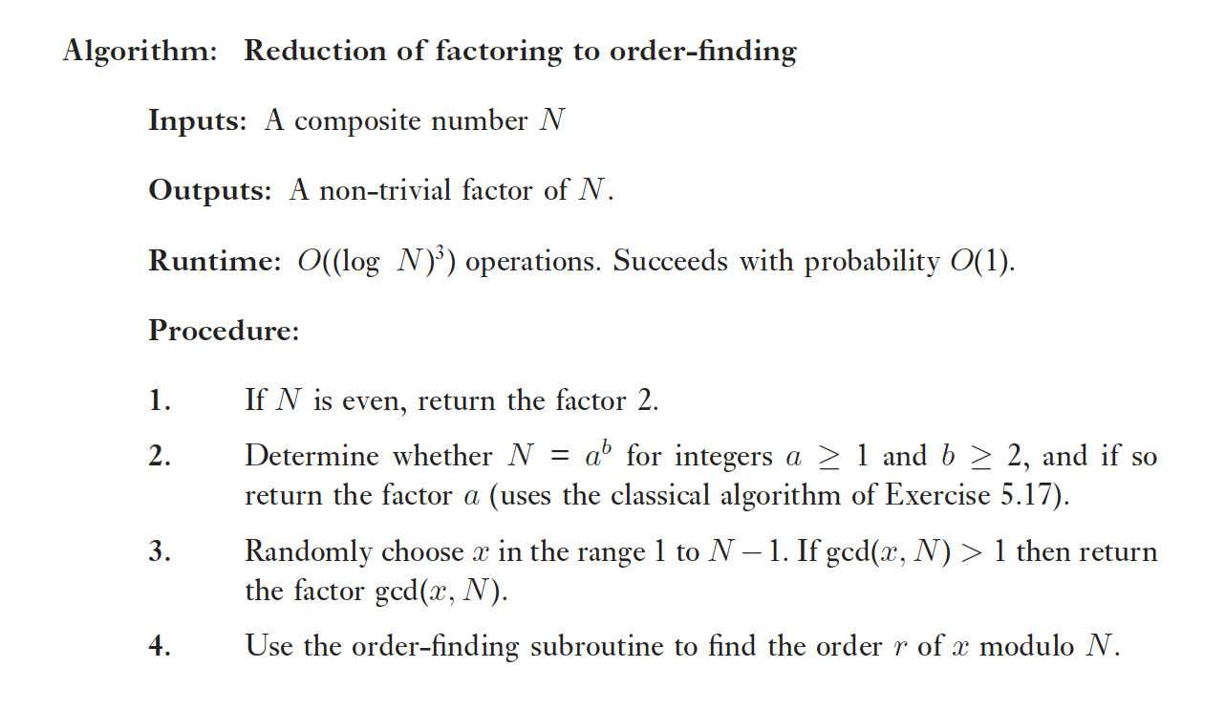
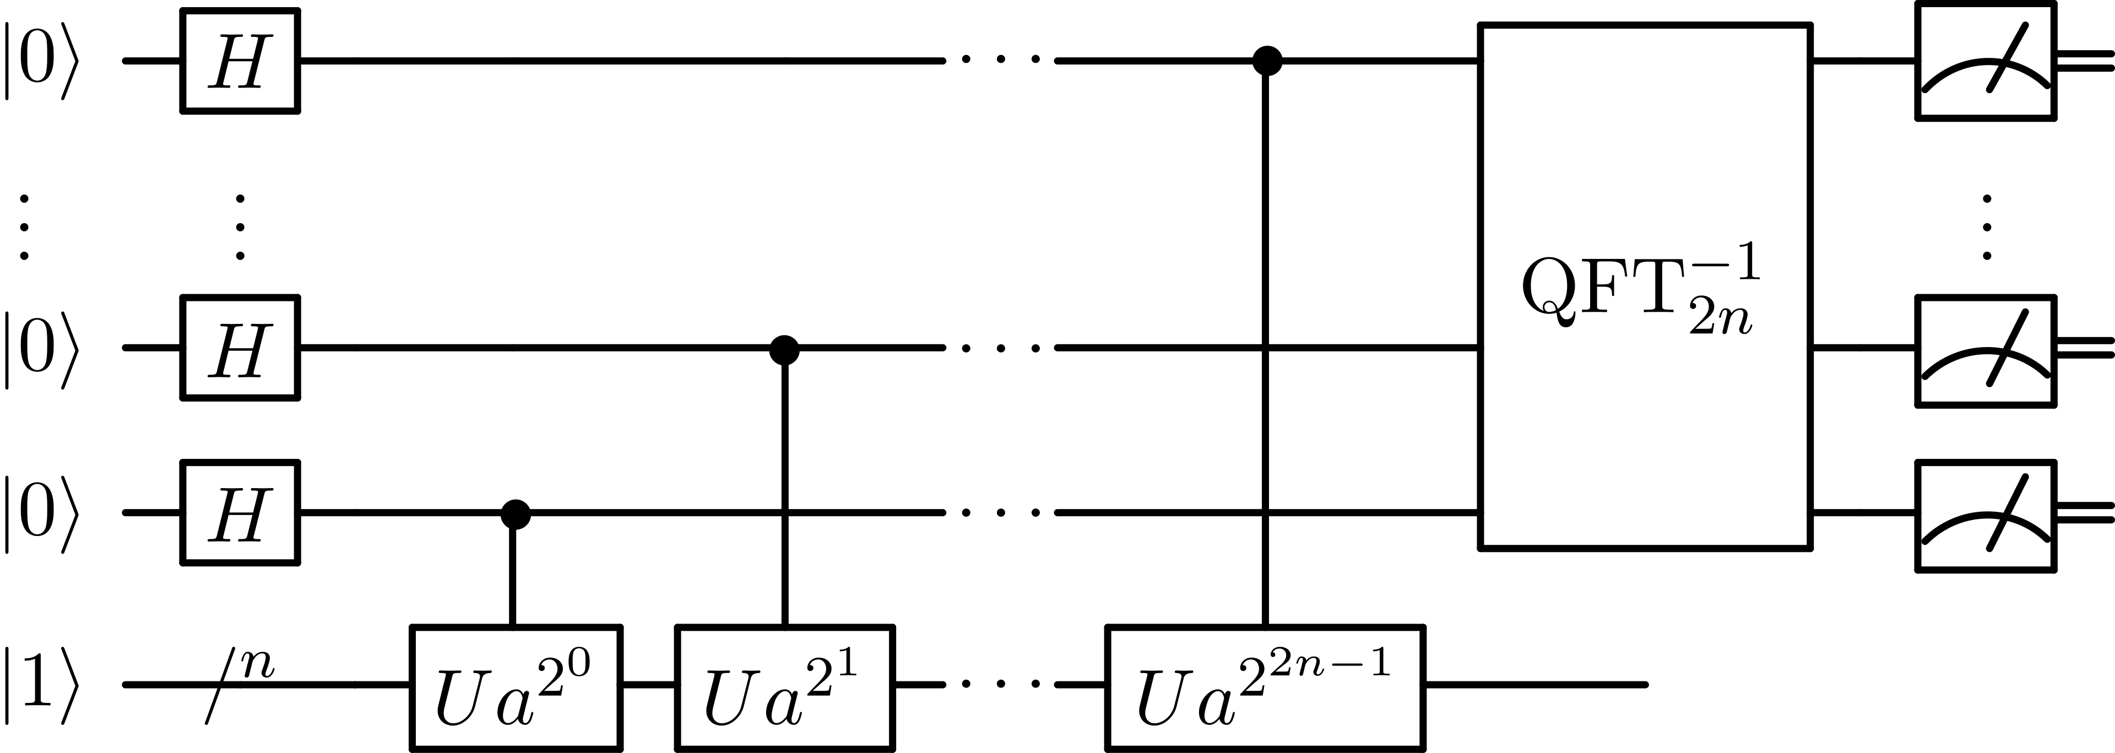
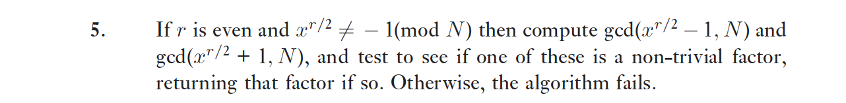
Shor‘s algorithm for integer factorization
Quantum Network Design GmbH
IMPORTANT: This algorithm has polynomial runtime → It reduces the runtime to practical values!
Algorithm from “Quantum Computation and Quantum Inforamtion” by Nielsen & Chuang
Figure taken from https://en.wikipedia.org/wiki/Shor%27s_algorithm#/media/File:Shor's_algorithm.svg

Slide 27
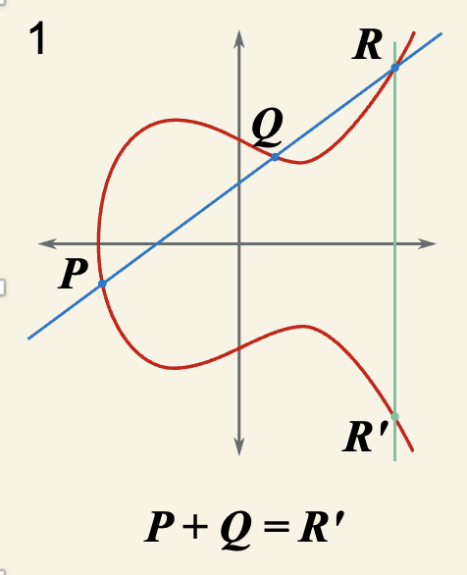
Elliptic curve (EC) crytography – Foundations
Quantum Network Design GmbH
Elliptic curve utilize group theory defined on algebraic curves. Many of these curves are described by an equation of the form:
y² = x³ –ax – b
This equation gives rise to curves in terms of points (x,y), and one can define a group on them:
To add P and Q, you intersect the line through them with the curve, and invert the resulting point on the x-axis
Figure taken from https://commons.wikimedia.org/wiki/File:ECClines-2.svg#/media/File:ECClines-2.svg

Slide 28
Elliptic curve (EC) crytography – Foundations
Quantum Network Design GmbH
For elliptic curves, one generates a key pair by chosing a random integer p which is between 1 and the curve order N:
p ∊ (1,N)
Because the group of an elliptic curve is generated by a single point G (called generator point) of the curve, this number p gives rise to a point on the curve:
P = p * G = G + G + … (p-times) + G
For the cryptography:
Public key = P (the point)
Private key = p (the integer that multiplies G)
Figure taken from https://commons.wikimedia.org/wiki/File:ECClines-2.svg#/media/File:ECClines-2.svg

Slide 29
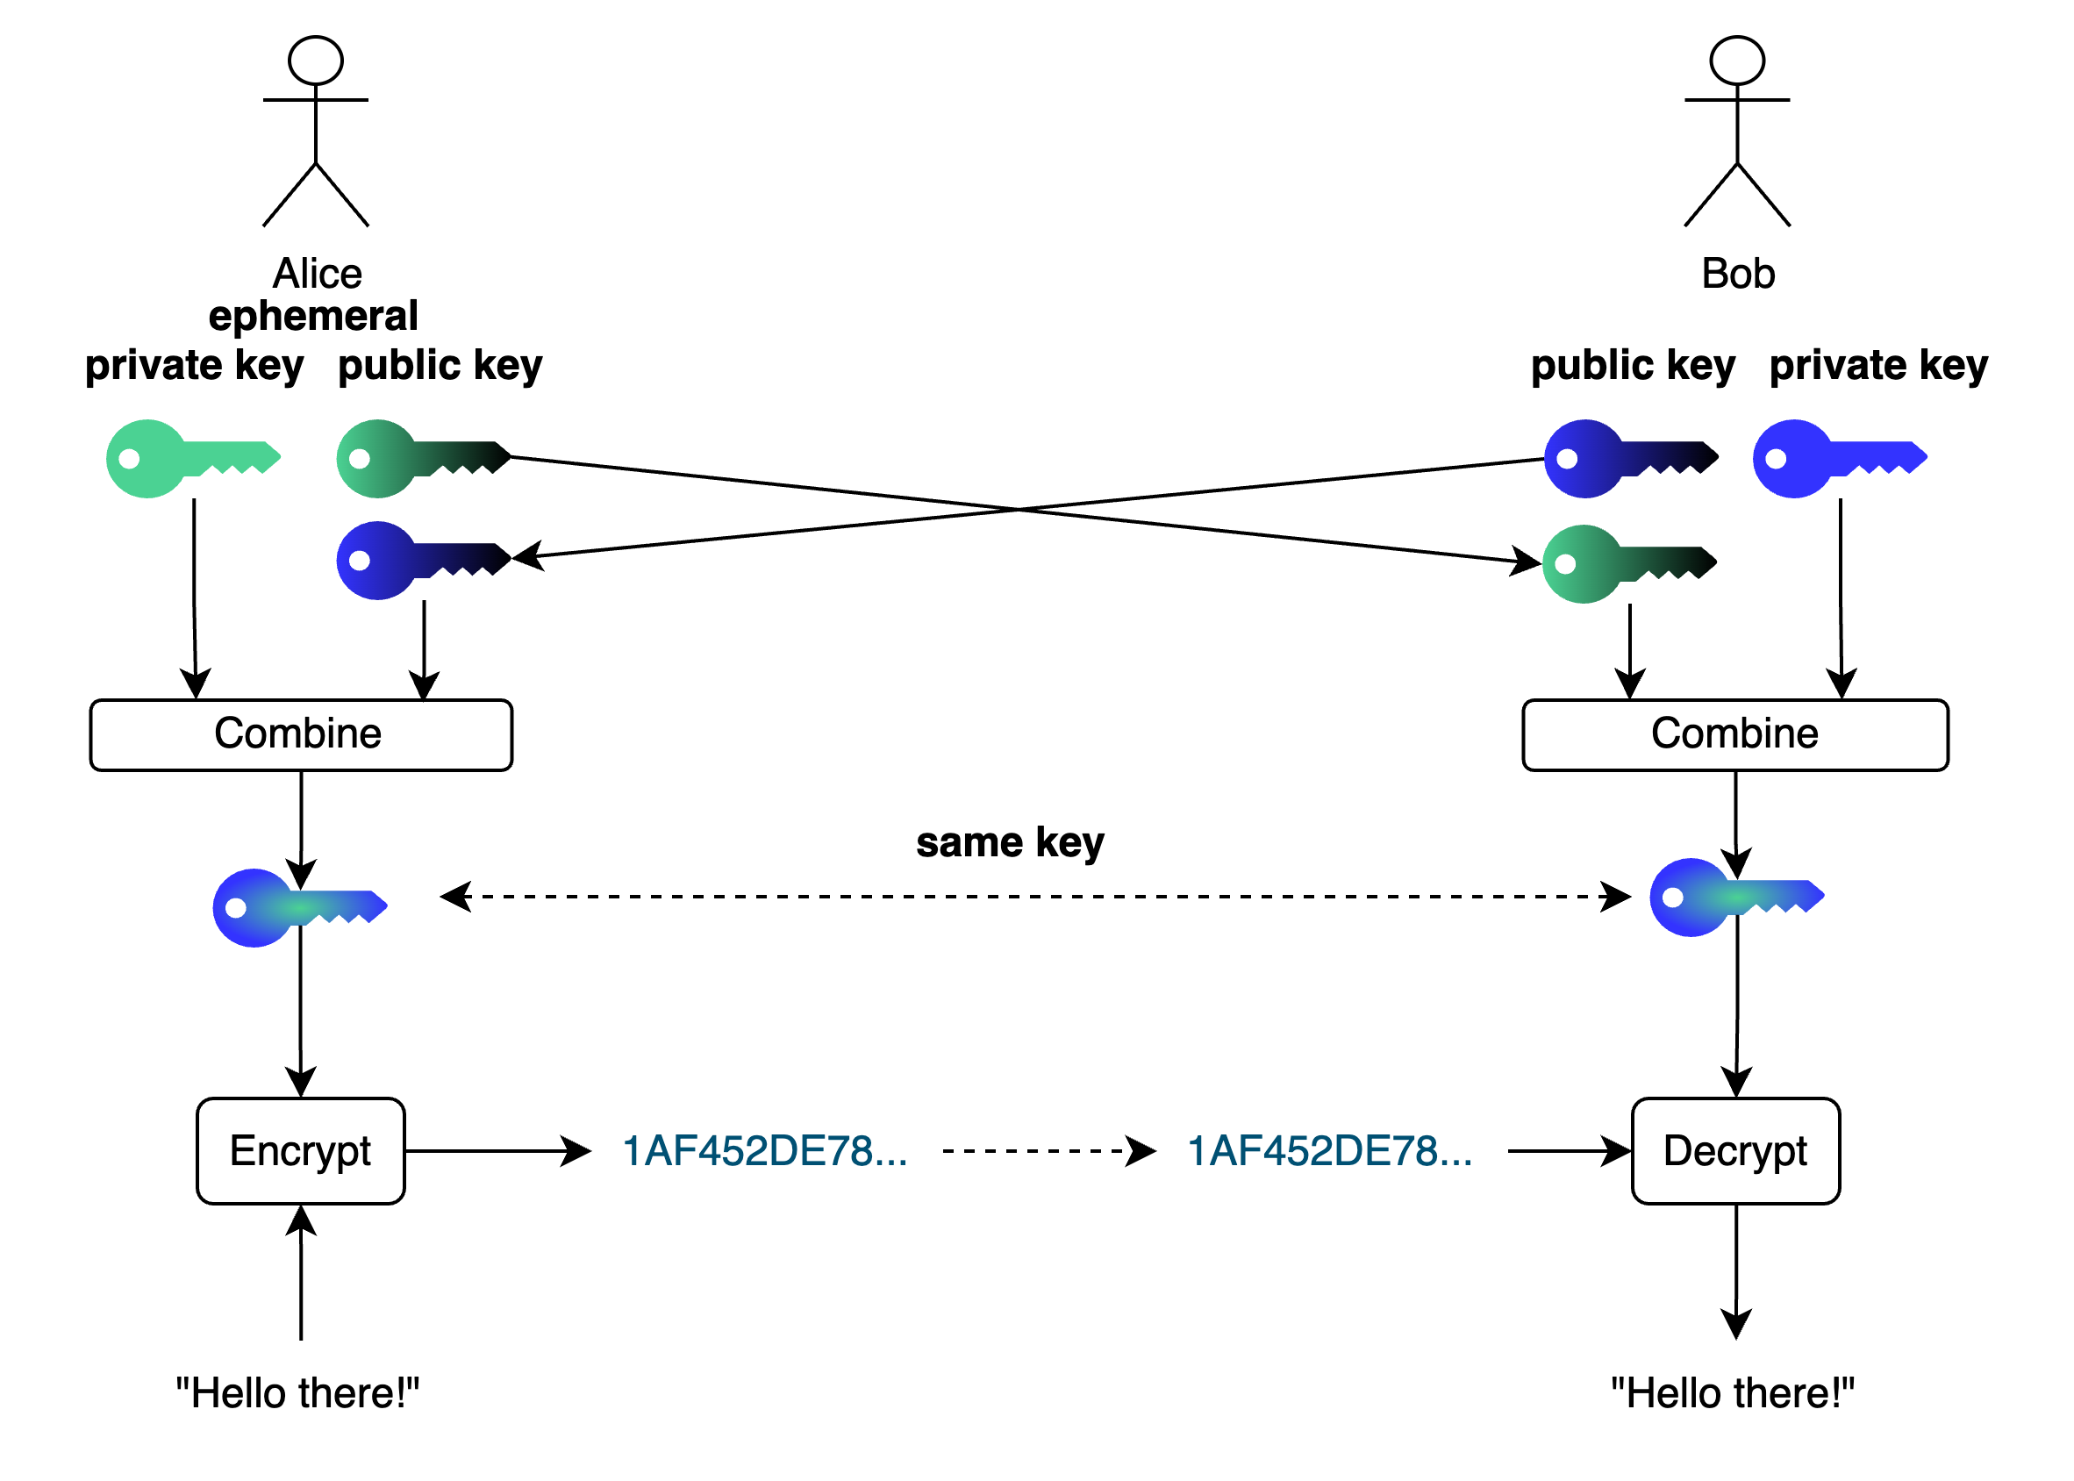
Elliptic curve (EC) crytography – Encryption (ECIES)
Quantum Network Design GmbH
Alice generates q which corresponds to point Q = q*G on the curve.
Bob has private key p with public key P = p * G.
Alice calculates (using public key of Bob):
q * P = q * p * G
Bob calculates (using public key generated by Alice):
p * Q = p * q * G
→ Both have the same point now!
Encryption of a message is done by generating another key pair, called ephemeral key pair, and performing a key exchange with the public key of the receiver. This gives rise to the same secret for sender and receiver to use in a symmetric cipher such as AES.

Slide 30
Elliptic curve (EC) crytography – What the security relies on?
Quantum Network Design GmbH
For encryption using elliptic curves, the security relies on the difficulty of solving the discrete logarithm problem for elliptic curves, which is at the heart of finding a private key for a given public key.
Given a point P, how often do I need to add the generator point G to itself to arrive at P?
Find x such that:
P = x * G
Figure taken from https://commons.wikimedia.org/wiki/File:ECClines-2.svg#/media/File:ECClines-2.svg

Slide 31
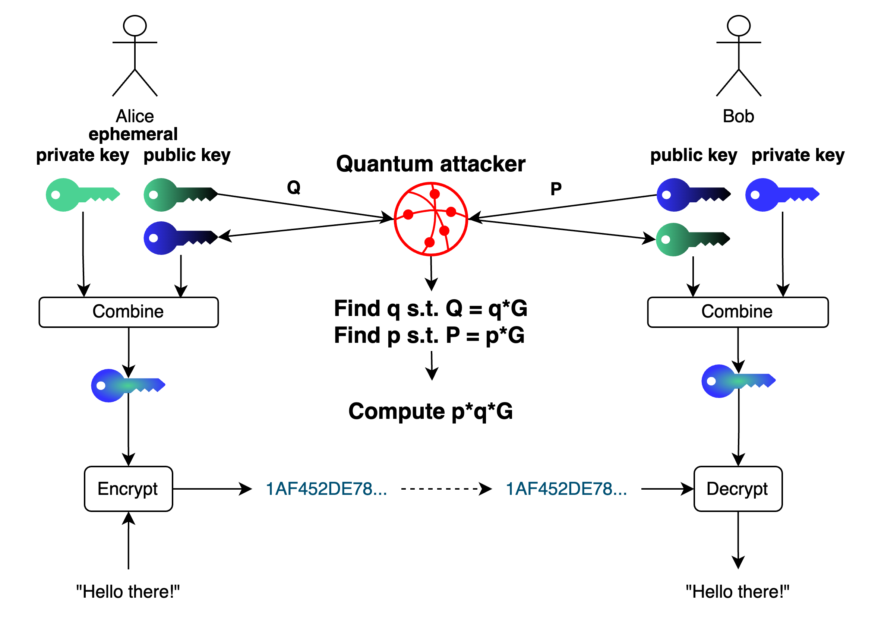
Shor’s algorithm for (EC) discrete logarithm
Quantum Network Design GmbH
There exists a similar algorithm as for factorizing integers for reconstructing the private key p solely by knowing the public key P.

Slide 32
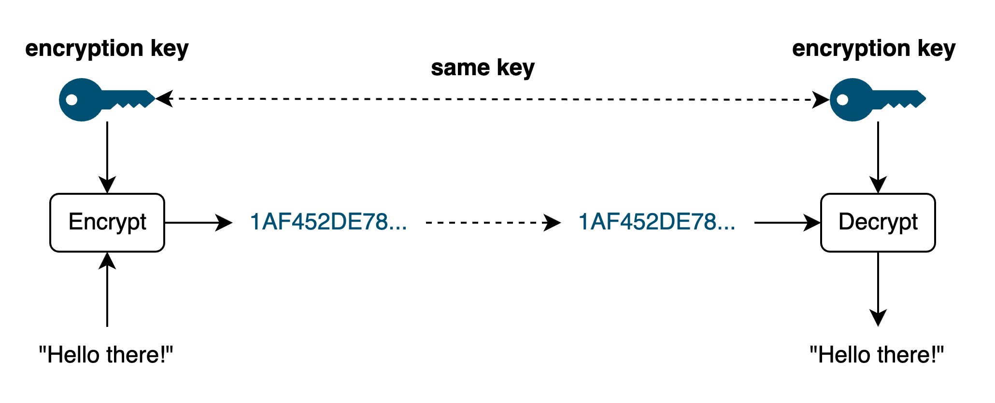
Symmetric encryption – What is the security relying on?
Quantum Network Design GmbH
For symmetric encryption, the situation is quite straightforward, the security relies on the randomness and length of the encryption key. For a key length l, we have in total 2^{l} different keys. Only the correct one decrypts the ciphertext.
→ when guessing the key, we try in the worst case 2^{l} different keys!

Slide 33
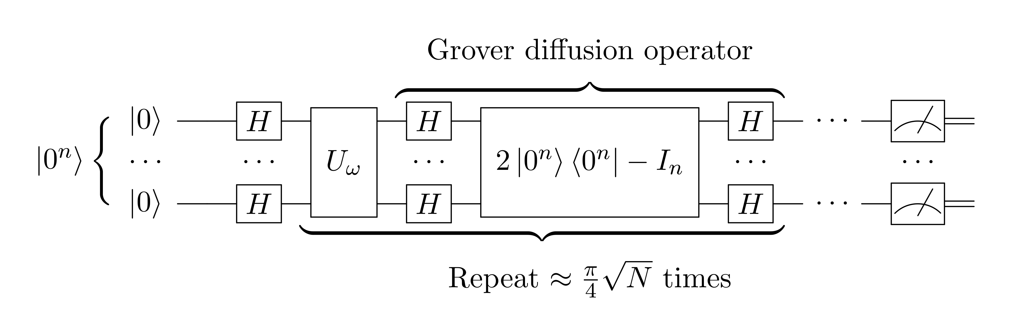
Grover’s algorithm
Quantum Network Design GmbH
Grover’s algorithm searches in a data set quadratically times faster than classicaly. The figure below shows its main ingredient the diffusion operator as a quantum circuit.
In general, it exploits a superposition of all possible keys to the encryption function, and the oracle marks the correct one as the ciphertext and plaintext is known.
→ using Grover’s algorithm we find the right key quadratically times faster than with a classical computer in terms of brute-force.
Figure taken from: https://en.wikipedia.org/wiki/Grover%27s_algorithm#/media/File:Grover's_algorithm_circuit.svg

Slide 34
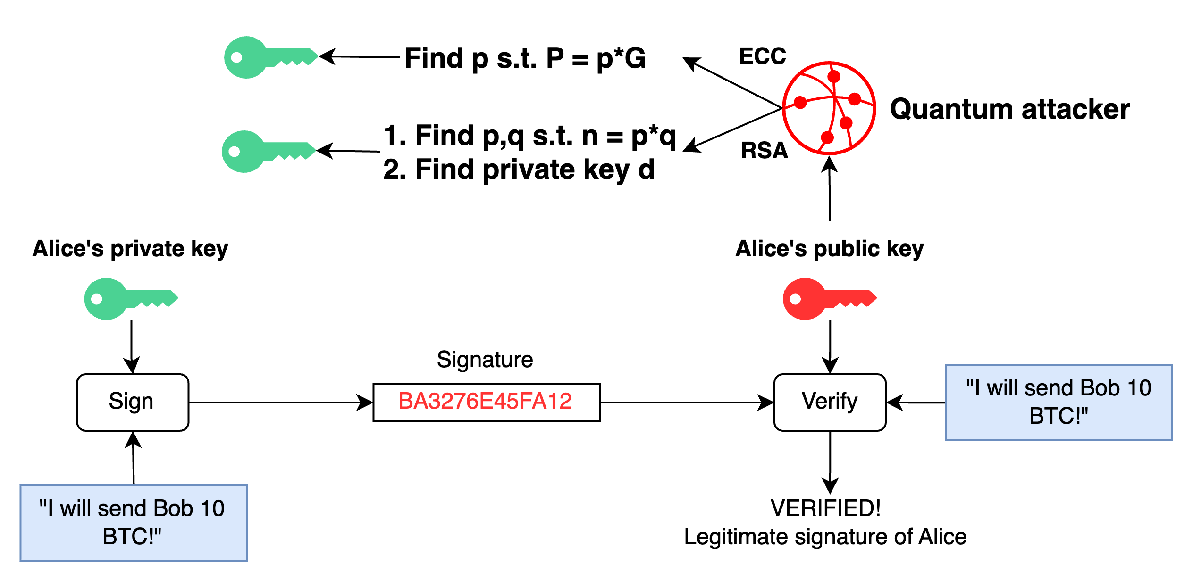
Digital signatures
Quantum Network Design GmbH
Shor’s algorithm reconstructs private keys, for both RSA and EC encryption. Hence, because RSA and EC encryption both break due to private key recovery, also their digital signature schemes break!

Slide 35
So to wrap up, what’s the situation?
Quantum Network Design GmbH
Symmetric encryption: Grover’s algorithm essentially halfes the complexity of finding the right key.
Asymmetric encryption:
  RSA: Because RSA builds on the difficulty to find the prime factors of a number, it breaks due to Shor’s algorithm for integer factorization.
  Elliptic Curve Cryptography: Most EC schemes use as public key directly the point on a curve, and this can be broken by using Shor’s algorithm for discrete logarithm problem on elliptic curves.
Digital signatures: As they rely on the same security primitives as asymmetric encryption, also these schemes break.
Key exchanges: Because key exchanges necessitate the exchange of public keys for RSA or elliptic curves, also the common Diffie-Hellman key exchanges are no longer safe.

Slide 36
A small case study …
Quantum Network Design GmbH

Slide 37
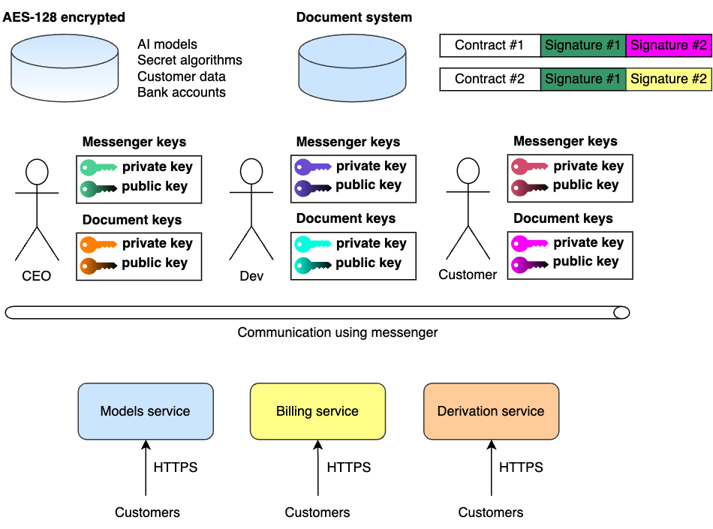
View on a system from a security perspective
Quantum Network Design GmbH
IT landscape of a software company: The company uses an AES encrypted darabase to store important information, developers, customers and CEO communicate using a messenger solution (using ECIES), and the company uses a document management system to sign important documents (RSA). Lastly, the company exposes its product via services relying on HTTPS to the world.

Slide 38
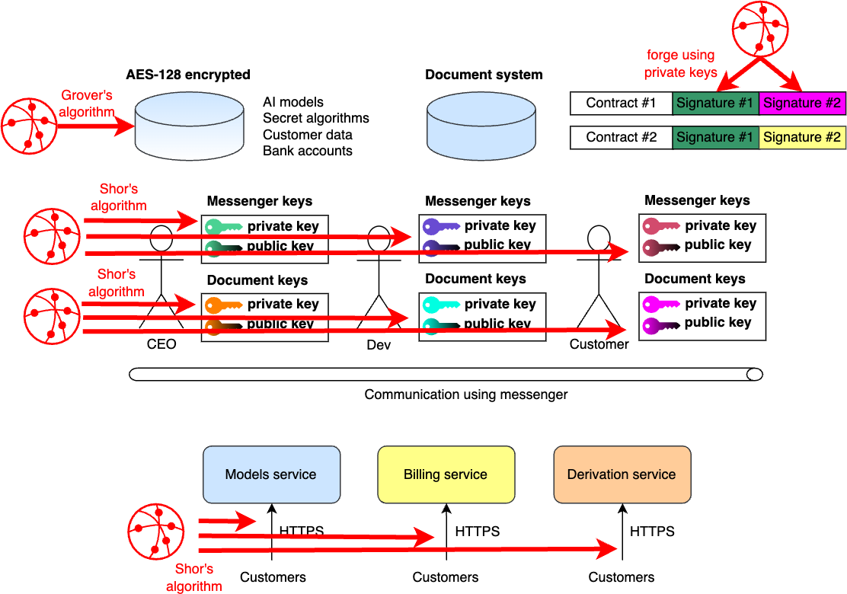
What does a quantum computer break here?
Quantum Network Design GmbH
How does a quantum computer threaten this landscape? The cryptography of all shown components breaks with quantum computers, either due to Grover’s algorithm, or Shor’s algorithm(s).

Slide 39
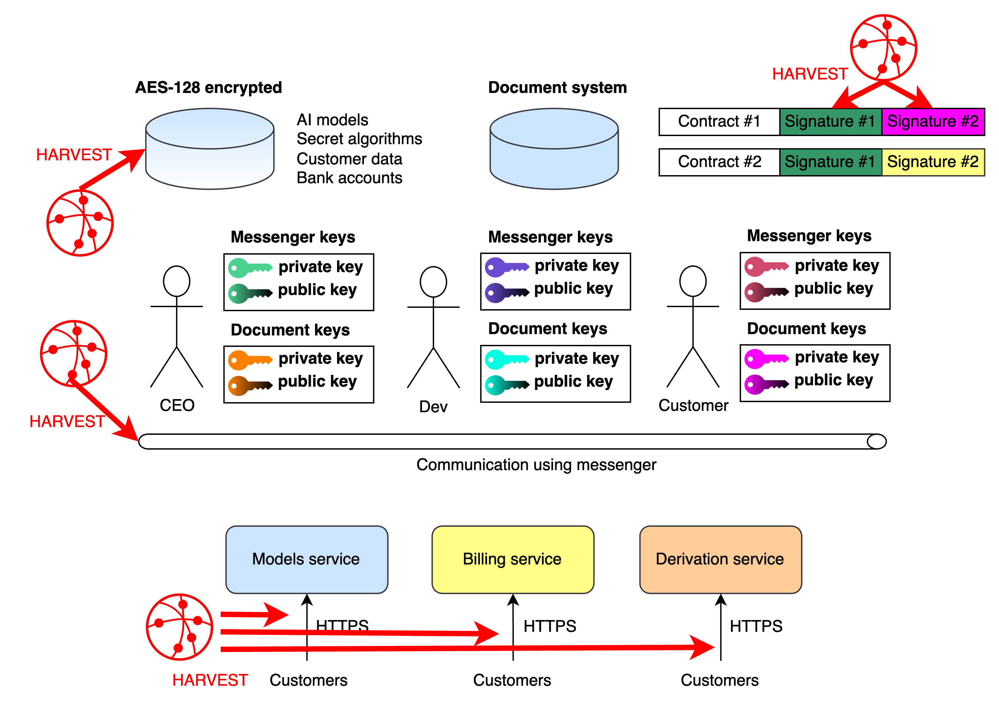
Harvest now, decrypt later …
Quantum Network Design GmbH
The main issues is that all the data can be (and already is) recorded now for later decryption by using a quantum computer (to e.g. recover private keys)! This corresponds to a real-world strategy and is adopted by present-day attackers.

Slide 40
What can you do about it?
Quantum Network Design GmbH

Slide 41
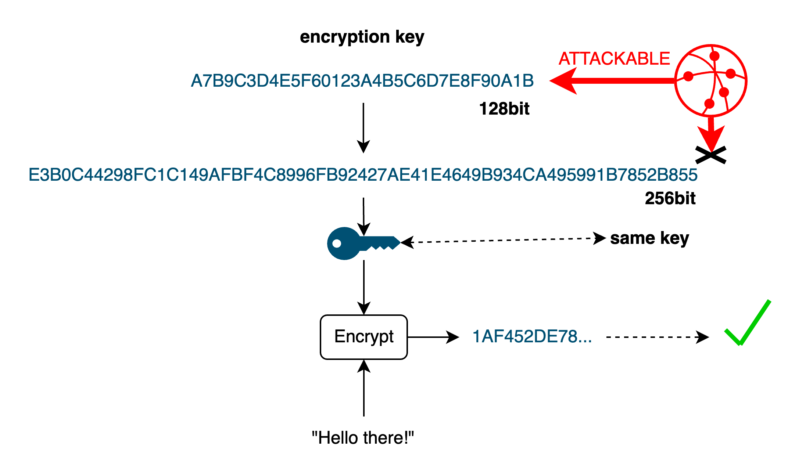
Symmetric ciphers
Quantum Network Design GmbH
Doubling the key length means going from
2^{l} bits
to
2^{2l} bits
For symmetric ciphers, the current recommendations of NIST and other security institutions is to simply double the key length, as this will render Grover’s algorithm less feasible for near term quantum computing devices.

Slide 42


Future trainings and workshops …
Quantum Network Design GmbH
Are you quantum safe?
In case you would like to know more about how to migrate to post-quantum secure cryptography to prevent the other issues pointed out, or simply work through your current security landscape to check whether it withstands attacks from quantum computers, reach out to CODE for consulting, trainings, or workshops.

Slide 43
Thank you for your attention.
Quantum Network Design GmbH
Questions?
Quantum Network Design GmbH
alexander.pirker@qnetworkdesign.com
office@qnetworkdesign.com
www.qnetworkdesign.com
apirker.consultant@gmail.com

