Slide 1
State of .NET
State of App and System Development
Markus Egger
President and Chief Software Architect
CODE Magazine & Consulting

Slide 2




Kicking Things Off
Jim Duffy
Director of Business Development
CODE Magazine & Consulting
Former Developer – Drawn to the Dark Side: Now Responsible for Marketing & Business Development
jduffy@codemag.com / My Bio
International Author and Speaker
Former Microsoft RD (Regional Director) 9 years
Former 11 time Microsoft Most Valuable Professional (MVP)
Twitter: @jmduffy

Slide 3

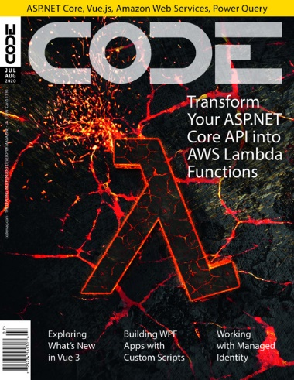










About CODE Consulting
“Helping People Build Better Software”
Custom Software Development, Training, Mentoring,…
Web, Cloud, Mobile, Desktop, Serverless, Databases,…
User Interface and Interaction Design
Project Rescue, App Modernization (VB, VFP, Access, etc.)
Development Team Staff Augmentation
Microsoft Certified Partner

Slide 4

Your Ticket to Free Consulting
Hour of CODE: One hour on us. Schedule a call today. Slots are limited.
No strings. No commitment. No credit card required.
Just help from our team of experience software developers.
Got questions? Stuck on an issue? Platform and/or architecture decisions to make? We can help!
Contact us at info@codemag.com or jduffy@codemag.com
https://codemag.com/OneHourConsulting

Slide 5

CODE Is Looking for REACT Developers!
Join the CODE Consulting Team!
Junior and Senior positions available
For current and future opportunities
Multiple positions available
FTE or Contractor opportunities available
Remote or on-site
https://bit.ly/3JCGLqC

Slide 6



Reference Links
Looking for work?
  https://www.codemag.com/Jobs
Want to write for us?
  https://www.codemag.com/Write
Need to add talent to your development team?
  https://www.codemag.com/Staffing

Slide 7







Social Networks
Subscribe to our YouTube channel: https://tinyurl.com/CODEYTC
Follow us on Twitter: @CodeMagazine
Facebook: www.facebook.com/CODEMagazine/

Slide 8
Free Subscription to CODE Magazine!
The leading software development magazine written by expert developers for developers
All registered attendees will automatically receive a free digital subscription to CODE Magazine – no need to do anything, it’ll happen auto-magically
Please share this free subscription link:
https://bit.ly/3sbzgB2

Slide 9



CODE Mobile App
Check out the new CODE Magazine Mobile application!
Available for iOS & Android
https://codemag.com/mobile

Slide 10
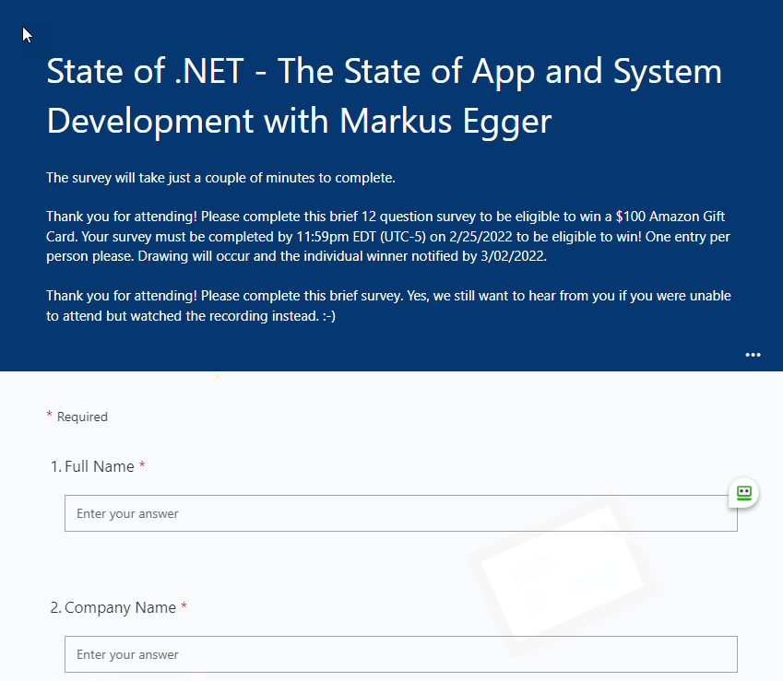
Event Survey – Win $100!
Complete this very short 12 question survey for a chance at a $100 Amazon Gift Card!
https://bit.ly/35bMd4w
Survey must be completed by 11:59pm ET on Friday 2/25/2022 to be eligible!
Name selected from registered attendee list. Completed survey is required to win.
THIS SLIDE WILL BE REPEATED AT THE END AND SURVEY LINK REPEATED IN THE CHAT WINDOW!

Slide 11

Build Cross Platform Apps With Photino
Build native, cross-platform desktop apps that are lighter than light.
Lightweight open-source framework for building native, cross-platform desktop applications with Web UI technology (HTML/CSS & JavaScript).
Photino is maintained by the CODE Magazine team with the help of the open-source community.
tryphotino.io
Github.com/tryphotino

Slide 12
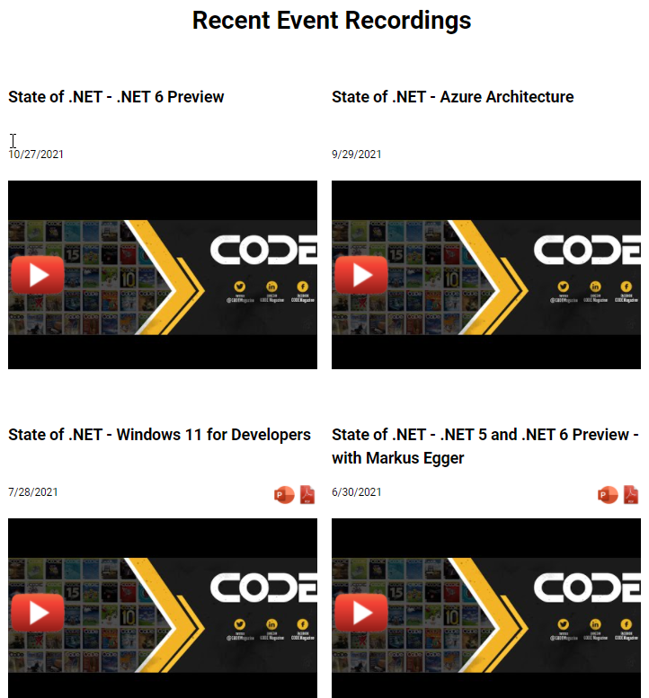
Prior Webinar Recordings
Slides & Videos:
State of .NET Webinar Series
  https://www.codemag.com/StateOfDotNet
CODE Presents Webinar Series
  https://www.codemag.com/CODEPresents

Slide 13


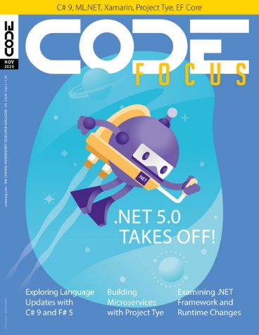
About the Presenter
Markus Egger
President and Chief Software Architect
EPS Software Corp. (dba CODE Consulting)
Publisher – CODE Magazine
International Author and Speaker
Microsoft RD (Regional Director)
Microsoft MVP 1995-2019
Email: markus@codemag.com
Twitter: @markusegger

Slide 14
Agenda
Developing Systems with .NET, Azure, and beyond
When to deploy what technology and/or technique
What are the characteristics of successful projects?
Keeping your sanity…

Slide 15
Where Are We At?

Slide 16
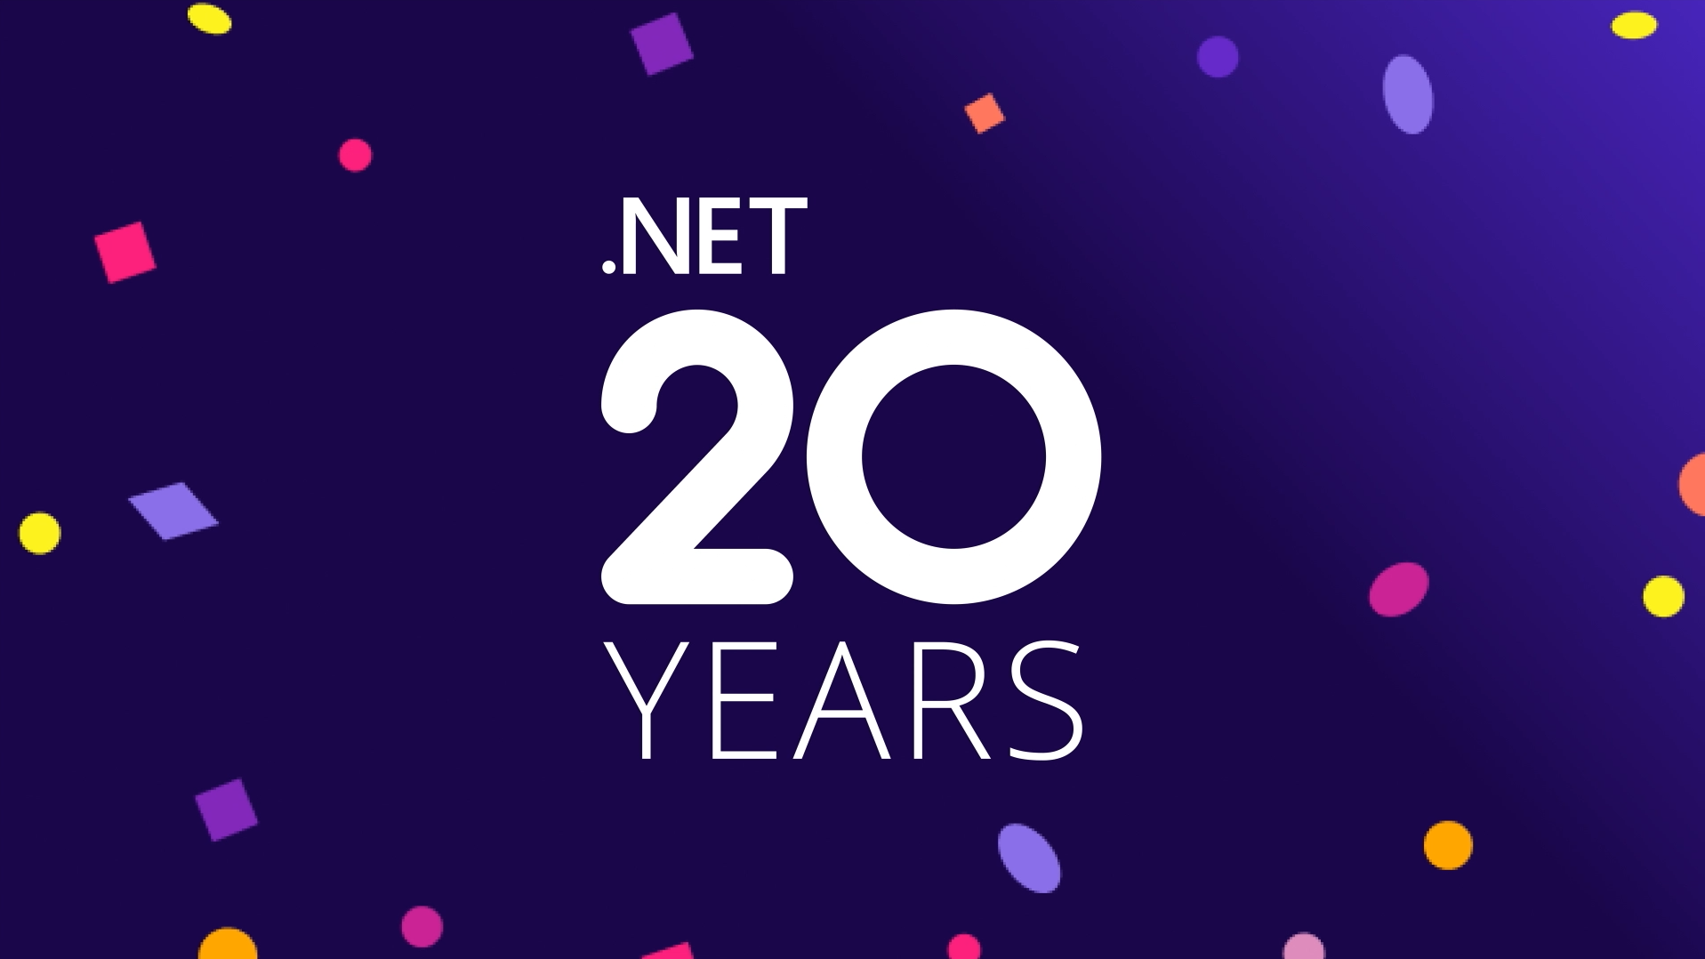

Slide 17
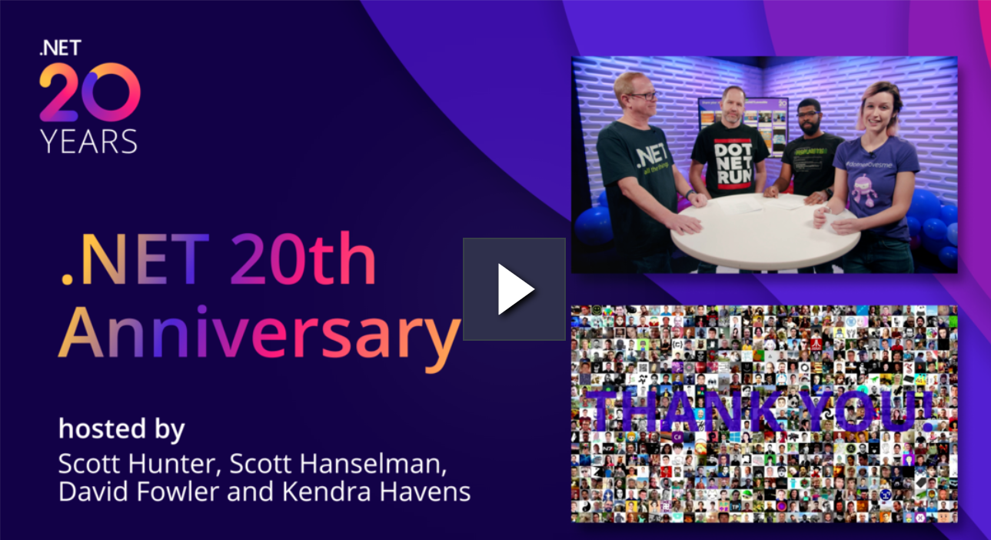
20 Years of .NET!
.NET just turned 20!
Visual Studio is about to turn 25!
https://dotnet.microsoft.com/en-us/

Slide 18
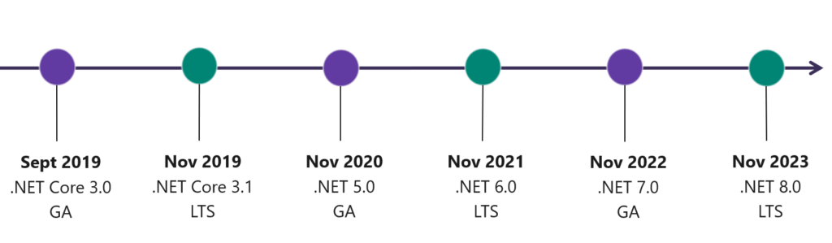
.NET Timeline/Roadmap
.NET 6 Release: November 9th, 2021
Annual, predictable releases (started with .NET Core 3.1)
Minor Releases if needed

Slide 19
.NET 6 on Azure
All the key Azure services support .NET 6 in all regions on Windows and Linux
Azure App Services
Azure Functions
Azure Static Web Apps
…

Slide 20
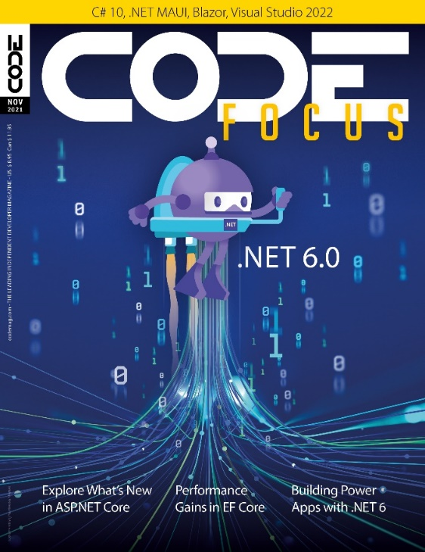
Side-Note: CODE Focus Magazine - .NET 6
We created CODE Focus issue on .NET 6
Great source of free information
Produced in conjunction with Microsoft
All CODE Magazine subscribers get
this special issue for free
Free online content at www.codemag.com/focus
Get a free subscription at:
www.codemag.com/subscribe/CF2021

Slide 21
Side-Note: CODE Focus Magazine - .NET 5
We also created CODE Focus issue on .NET 5
Also produced in conjunction with Microsoft
Content is still available online and
very applicable today

Slide 22
.NET 5 – End of Support
.NET 5 Extended Support ends May 8th, 2022
Apps will continue to run, but will not be patched
Transition to .NET 6 by then if possible
  Which should be exceptionally easy to do

Slide 23
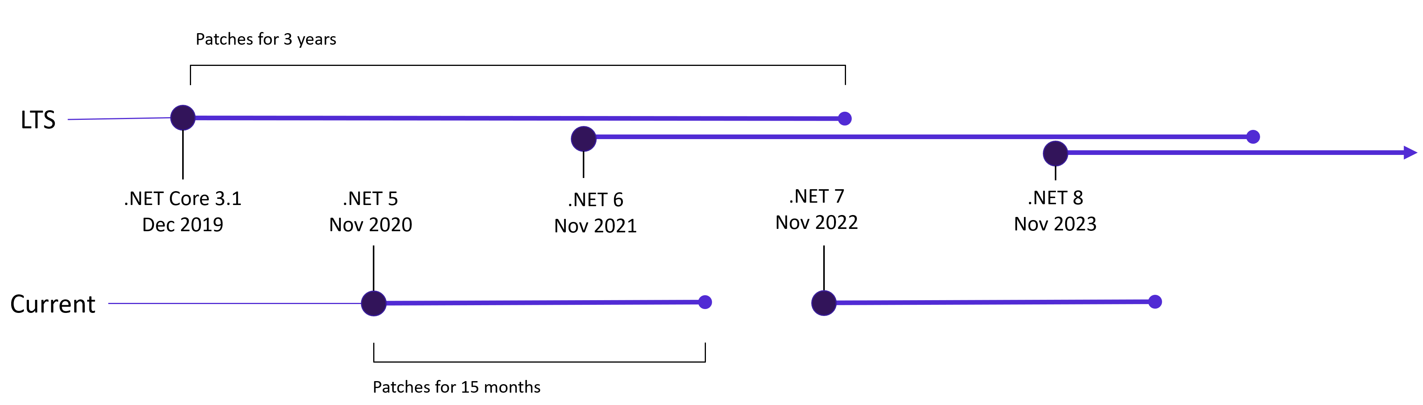
GA/Current vs. LTS
Current versions (GA) are supported 15 months
  (3 months after the next version’s release date)
LTS versions are supported for 3 years
It should be easy to update from GA to LTS versions

Slide 24
.NET 7 Preview 1
.NET 7 Preview 1 is now available for download
https://devblogs.microsoft.com/dotnet/announcing-net-7-preview-1/

Slide 25
Successful Projects

Slide 26
Characteristics of Successful Projects
Productive
Learnable
Architecturally capable to adjust and compensate for various scenarios and shortcomings (that every project has in some way)
Deploys the technologies and techniques that match the problem that needs solving

Slide 27
But What About…?
Testability
Scalability
Reuse
Best Practices

Slide 28
Characteristics of Unsuccessful Projects
Even after a lot of training, teams are not very productive
Even relatively senior developers struggle
Things that are common are not easy
Lots of investments into a nebulous future
Lots of high architecture and best practices, but little to show in terms of actual features and milestones

Slide 29
Security
Security can’t be added to a project late, if it is inherently non-secure
Security is a mind-set that needs to be present from day 1

Slide 30
The Cloud
Many systems have now become truly Cloud-Native
This means that systems have a strong tie to specific clouds
An understanding of various cloud options is therefore very important to project success

Slide 31
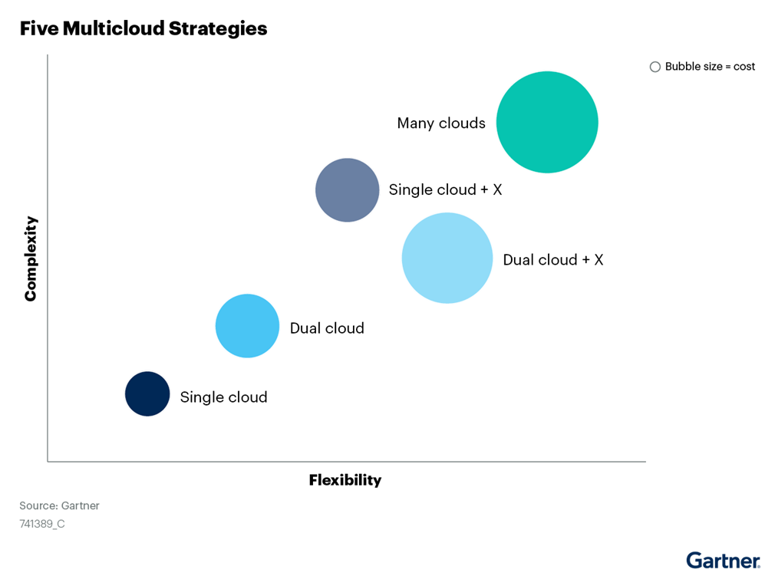
Multi-Cloud Strategies

Slide 32
Aspects you don’t control
In a Cloud and Package driven development world, there are always aspects you do not control
Things that work perfectly fine may be pulled from production by your provider
  Cloud providers may pull a specific feature that is core to your system
  Example: Third party login may stop being supported
  Example: Payment option you implemented may go away
  Example: Email system you use may stop being supported
At that point, you have little choice but to drop everything you are doing and fix the issue

Slide 33
Code Longevity
How long do you expect your system to be around?
  It will probably be used at least twice that long
How much technical debt to you want to take on?
How are you managing and mitigating technical dept? How do you expect to “pay it back”?
Throw-away code can be surprisingly attractive
Data lives the longest, followed by the “middle tier”
UIs come and go

Slide 34
DevOps
DevOps is an important aspect of many serious projects
It is difficult to envision a sophisticated build process (including testing, regular builds and deployments, and more) without a good DevOps process
However, that includes a lot of processes and tasks that need to be done and handled
  Do not underestimate this effort! You will need someone who can devote considerable time to this.

Slide 35
Specific Technologies

Slide 36
Front End – Browser Apps
Angular, Vue.js, REACT, and several others are perfectly viable UI technologies that all work fine for what they are
Blazor has been going very well too
Traditional server-side development with ASP.NET MVC is also still a viable option for systems that are “sites” rather than “apps”

Slide 37
Front End – Mobile
Two schools of thought:
  Build once, run everywhere
  Build for the two major platforms separately (iOS and Android)
Both work, but don’t expect magic from #1
Various cross-platform technologies, such as MAUI/Xamarin, REACT Native, and others
For true native development, build separate Swift and Java projects
In my experience, the effort for 2 separate projects is not that much more than cross-platform

Slide 38
Side-Note: MAUI
MAUI still hasn’t been released
However, the first Release Candidate (RC) for MAUI should be just around the corner
We do not yet know how much of an impact MAUI will make…
…but some of it seems to be pretty cool

Slide 39
Front End – Desktop
Desktop applications are still more of a thing than many people would have you believe
Modern desktop development is usually a mix of all kinds of technologies (“Project Reunion”)
If often starts with WPF

Slide 40
Related Topic: Desktop Training
Check out www.codemag.com/training for our upcoming training classes on this topic
We are doing the first Desktop development training class in years, due to demand

Slide 41
APIs/Services
Good separation of the UI from APIs is the standard in all modern systems – for good reason
APIs are implemented as micro-services in a variety of ways…
…and deployed and scaled in a variety of ways
App Services, Containers, serverless computing,…

Slide 42
Data Persistence
Never had more options for data storage than now…
…most of which work perfectly fine
SQL Server, Cosmos DB, Blob Storage, Cognitive Search, and many many other technologies work perfectly fine
We have many architectural debates about whether micro-services should really all get their own databases or not, and many similar issues…
  …none of which have ever turned out to be make or break issues for project success

Slide 43
Azure Services Developers Should Know
In previous State of .NET events, I talked about Azure Services every developer should know
Today, we will revisit those and see when you should use them

Slide 44
App Services
Web Apps, Mobile Apps, API Apps, etc.
  Think “I want to run a web site on Azure”
Fully managed: OS patching, high availability, scaling
Consider Linux as a viable platform, which is usually considerably cheaper and works very well with .NET!

Slide 45
SQL Server Databases
There are several different ways to host an SQL Database right on Azure
The most “native” is to run an “SQL Azure” database
  This is a service that is fully managed for you. You just create the database and tables you want
  This is a cloud-optimized version of SQL Server that you do not have to maintain
You can also run “SQL Server on Azure”
  This is essentially a pre-configured virtual machine that you can host your database on
  It’s much like your local SQL Server, but hosted in the cloud for you

Slide 46
Azure Storage
Blobs, tables, queues & files
Auto replicated & backed up
Optional Geo-replication
Think of this as a “limitless, high-performance, high-reliability file system in the cloud”
Different tiers are available for cost-efficient storage

Slide 47

Azure Functions
Serverless
  Which most def. does NOT mean “no servers”. It just means you do not have to worry about the servers involved.
  You will never be exposed to server provisioning or management
  You simply say “Go ahead, Cloud!... Run this stuff of mine!”
Event driven off HTTP, Queues, Timers, etc.
  Great for simple jobs & workers
Pay for resource usage

Slide 48
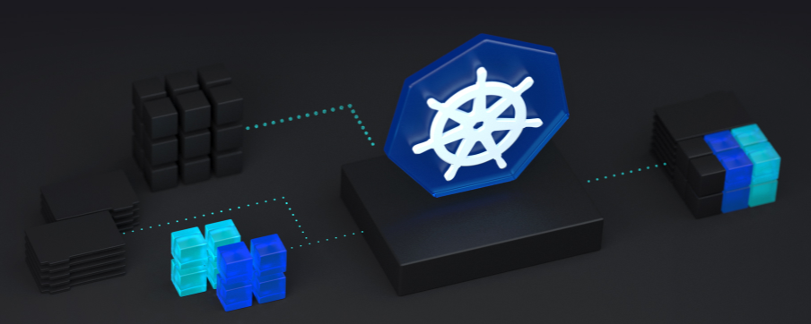
Azure Kubernetes Service
Managed, serverless Kubernetes Service
Great service to deploy and orchestrate container deployments
Now also supports Windows Containers
Azure Arc-enabled Kubernetes supports spanning clusters across data-centers, multi-cloud, and Azure Stack

Slide 49

Cosmos DB
NoSQL Database specifically engineered for the cloud
Limitless scale
Fully managed
Serverless
Multi-APIs (MongoDB, Casandra,…)

Slide 50

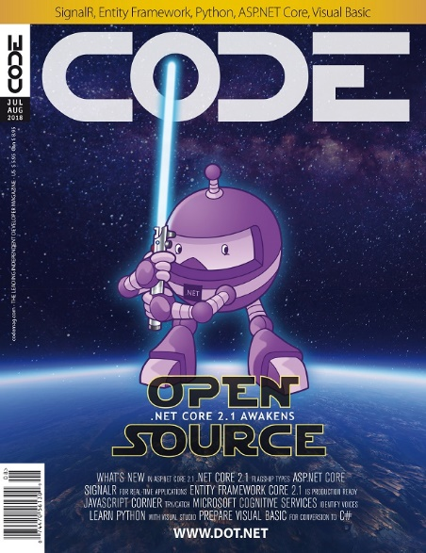
Microsoft Cognitive Services
Vision
Speech
Language
Knowledge
Search
https://azure.microsoft.com/en-us/try/cognitive-services/
https://www.codemag.com/Article/1805031/Identify-Faces-with-Microsoft-Cognitive-Services
https://www.codemag.com/Article/1807031/Identify-Voices-with-Microsoft-Cognitive-Services
Notes:
https://upload.wikimedia.org/wikipedia/commons/8/84/Ted_Nugent_at_White_House_in_April_2017.jpg
http://www.invisibleoranges.com/files/2013/10/Ted-Nugent-e1381435169876.jpg
http://images.tritondigitalcms.com/6616/sites/356/2018/09/19074930/Paul-McCartney-Let-it-Be.jpg
https://i.pinimg.com/originals/75/da/5c/75da5c063757190abbf8ae3ab0f115f6.jpg
https://pmcvariety.files.wordpress.com/2017/06/paul-mccartney.jpg
https://cdn1.thr.com/sites/default/files/imagecache/scale_crop_768_433/2011/06/dsc0111phgnrph_gene_page_a_l.jpg
https://pmctvline2.files.wordpress.com/2018/07/twd_816_gp_1114_0612_rt.jpg

Slide 51
Other Announcements

Slide 52
Event Survey – Win $100!
Complete this very short 12 question survey for a chance at a $100 Amazon Gift Card!
https://bit.ly/35bMd4w
Survey must be completed by 11:59pm ET on Friday 2/25/2022 to be eligible!
Name selected from registered attendee list. Completed survey is required to win.

Slide 53


Slide 54


Slide 55
Desktop Development Training
We are about to finalize a class for Desktop Development
WPF, WinForms, .NET 6, WinUI, Windows App SDK,…
Watch for announcements over the next few days!
www.codemag.com/training

Slide 56


Free Subscription to CODE Magazine!
The leading software development magazine written by expert developers for developers
All registered attendees will automatically receive a free digital subscription to CODE Magazine – no need to do anything, it’ll happen auto-magically
Please share this free subscription link:
https://bit.ly/35bLLTS

Slide 57
Join the CODE Consulting Team!
We’re Hiring Developers!
Senior C# Developer
.NET Desktop Developer
WPF Developer
SSRS Report Developer
REACT Developer
ASP.NET MVC Developer
https://codemag.com/Jobs

Slide 58
Your Ticket to Free Consulting
Hour of CODE: One hour on us. Schedule a call today. Slots are limited.
No strings. No commitment. No credit card required.
Just help from our team of experience software developers.
Got questions? Stuck on an issue? Platform and/or architecture decisions to make? We can help!
Contact us at info@codemag.com or jduffy@codemag.com
https://codemag.com/OneHourConsulting

Slide 59
CODE Mobile App
Check out the new CODE Magazine Mobile application!
Available for iOS & Android
https://codemag.com/mobile

Slide 60
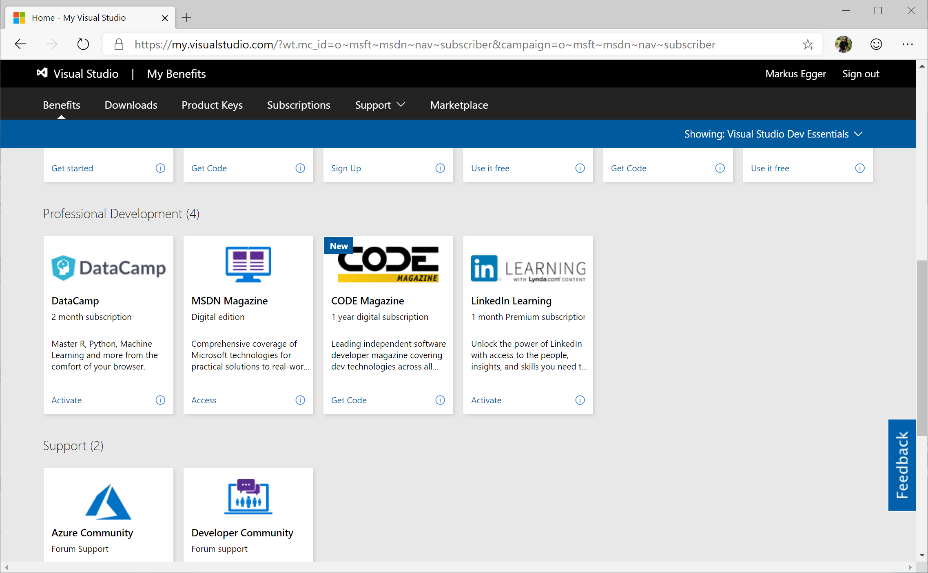
CODE Magazine as a Microsoft Benefit
As a Visual Studio Subscriptions customer, you qualify for a free, one year print and/or digital CODE Magazine subscription!

Slide 61
Q&A
Contact us with questions!
CODE/EPS Contact:
www.codemag.com
info@codemag.com
facebook.com/codemag
twitter.com/codemagazine
Presenter Contact:
markus@codemag.com
jduffy@codemag.com

