Slide 1
Building AI Solutions with Microsoft.Extensions.AI
Mike Yeager
CEO of CODE Consulting

Slide 2

Mike Yeager
CEO CODE Consulting
Senior developer and manager
AI project lead
Writer & speaker
MS Azure contributor
myeager@codemag.com

Slide 3


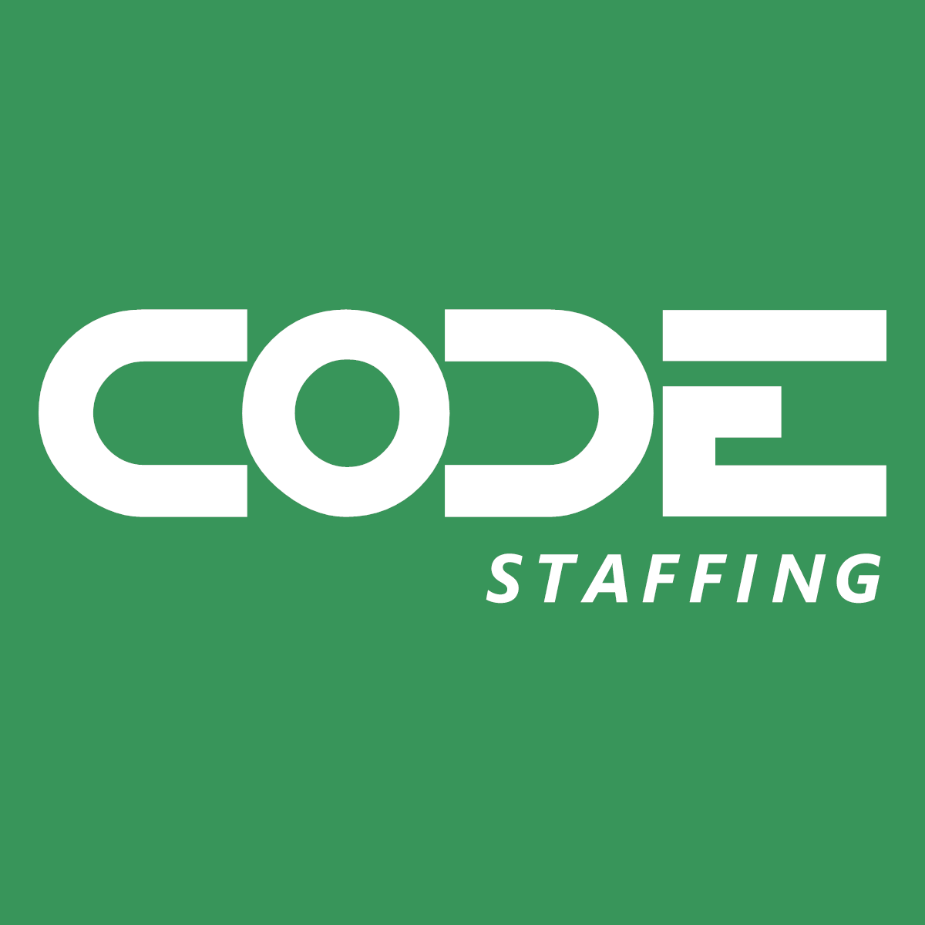

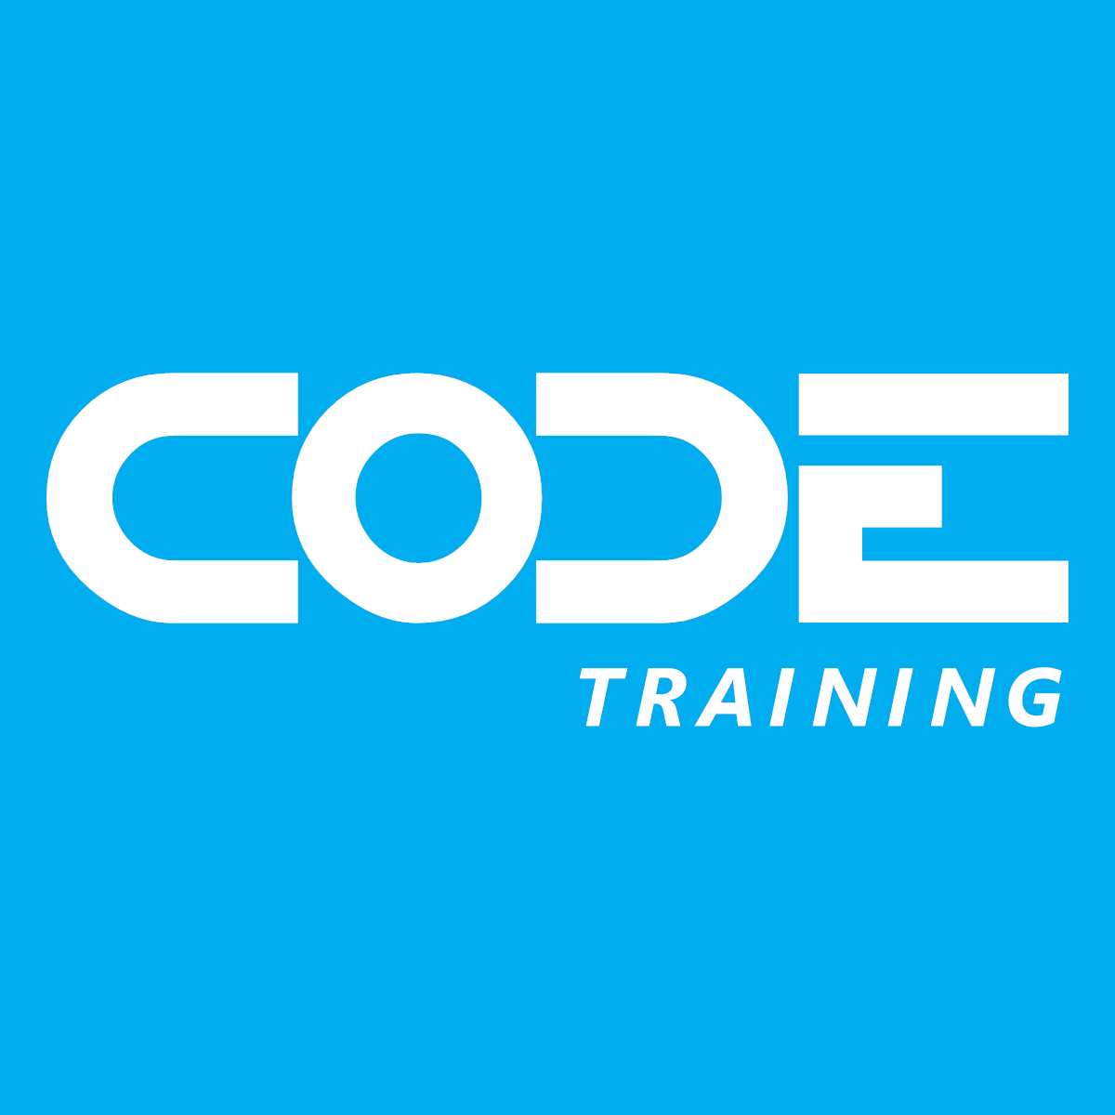

Slide 4
Agenda
What is Microsoft.Extensions.AI?
Why do I care?
Which providers does it support?
When do I choose it?
How do I use it?
Q & A

Slide 5
What is Microsoft.Extensions.AI?
Mid-level, provider agnostic libraries for coding AI tasks
  Text Completion
  Chat
  Tool Calling
  Embeddings (semantic search)
  Image Generation
  Caching
  Telemetry

Slide 6
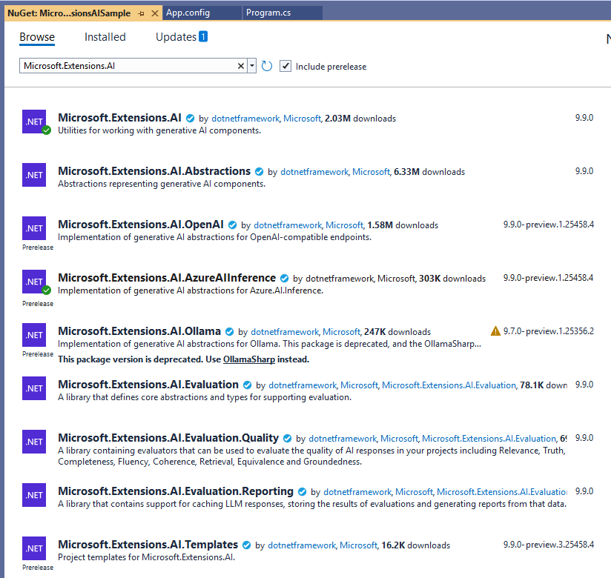
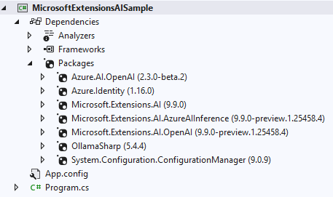
NuGet Packages

Slide 7
Why do I care?
Coding to specific APIs locks you in
It’s tedious to write low level code for things like streaming responses or maintaining chat history
You have to learn different APIs for different tasks
You can use things like caching and telemetry fairly easily

Slide 8





Which providers does it support?
Open AI
Azure Open AI
Azure Foundry Models
Ollama
Create your own provider
  Anything using the Open AI protocol
  Phi Silica
  Onyx

Slide 9
When do I choose it?
Low-Level: Writing directly to provider specific APIs and SDKs may be a good choice if you’re locked-in to a provider and want low-level control
Mid-Level: Using Microsoft.Extensions.AI may be a good choice for light weight, composable, abstract coding
High-Level: Using a high-level framework like Semantic Kernel may be a good choice for higher level tasks like building agent frameworks, doing orchestration, and using prompt templates

Slide 10
How do I use it?
IChatClient
IImageGenerator
IEmbeddingGenerator
Assistant, Audio, Streaming, OpenTelemetry, Logging, Caching, Chat History, Dependency Injection, Builders, etc.

Slide 11
Demo

Slide 12



Free Subscription
The leading software development magazine,
written by expert developers for developers.
All registered attendees will receive a
free digital subscription to CODE Magazine!
Share this link to our free subscription:
bit.ly/CP1025Subscribe

Slide 13
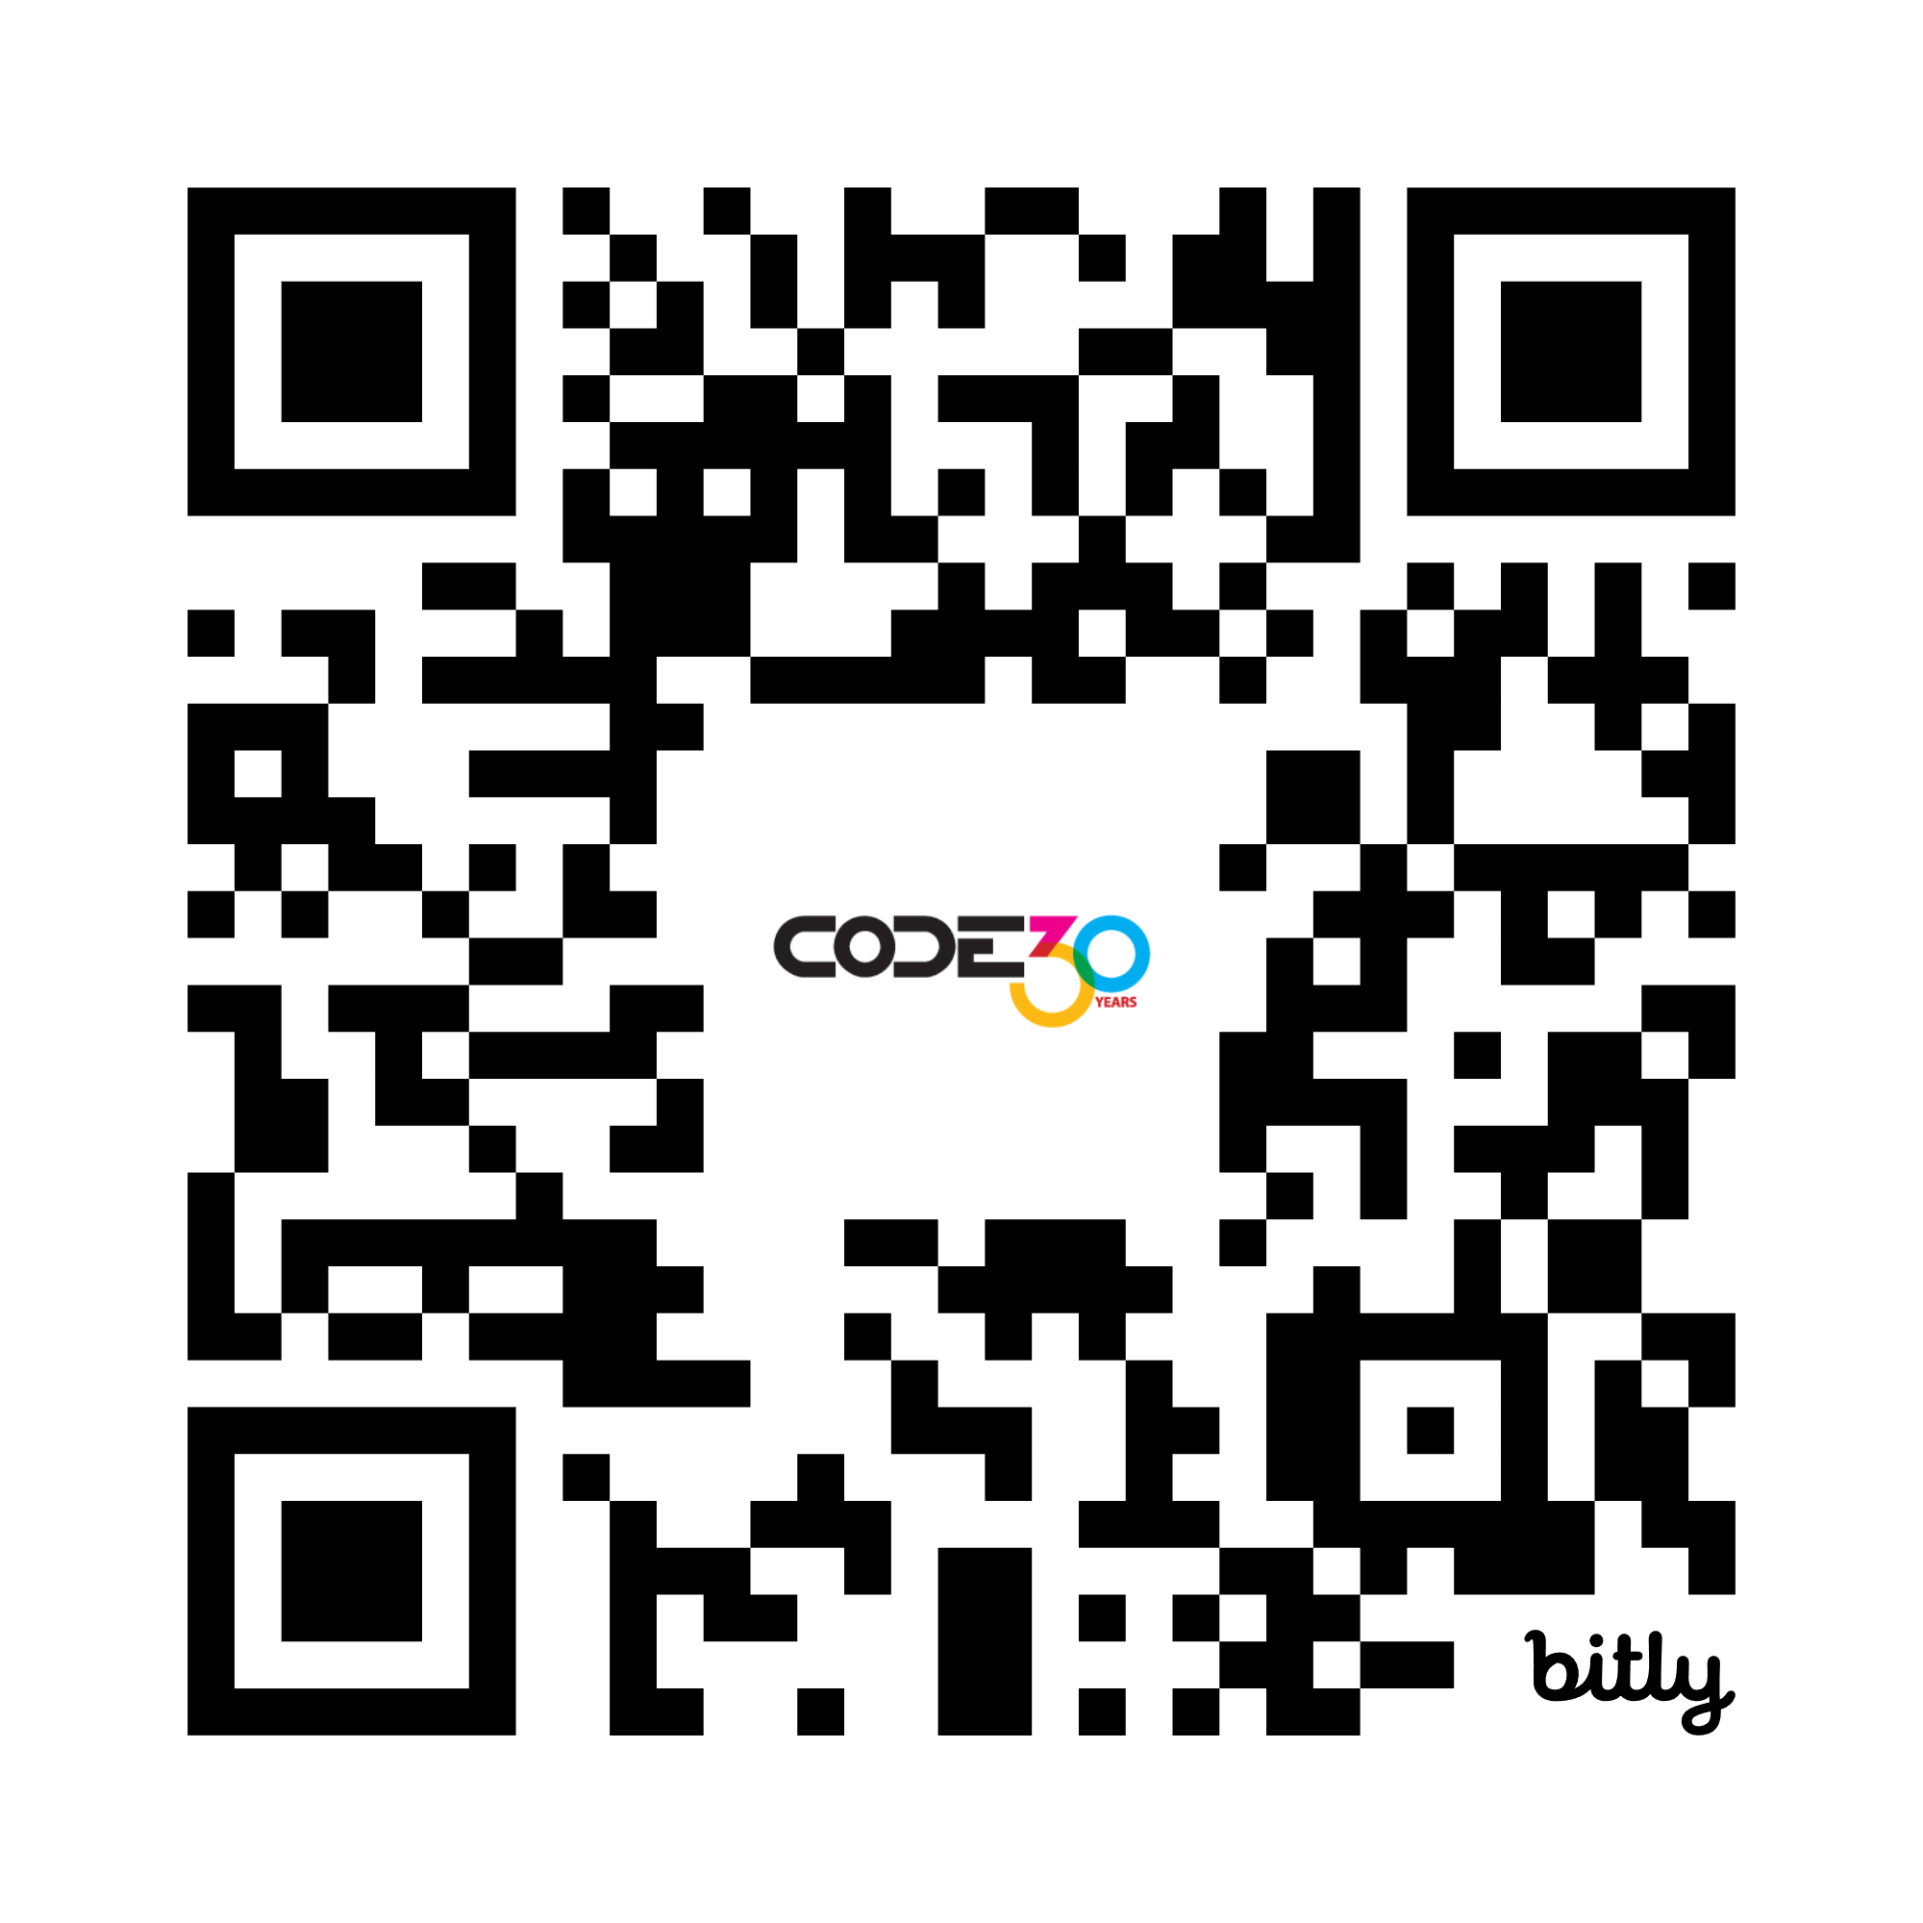
Please take the survey
bit.ly/CP1025Survey

Slide 14

AI Executive Briefings
Check out our new Executive Briefing offer!
We can help with your AI needs
What does AI mean for you?
codemag.com/AI
codemag.com/ExecutiveBriefing

Slide 15

CODE Staffing
Disrupting the world of staffing!
Giving our customers the ability to have
staff on par with Silicon Valley companies …
… and our employees a work environment
in a bleeding-edge tech company with
the industry leading benefits!
codestaffing.com

Slide 16

WE NEED YOU!
codestaffing.com/careers

Slide 17

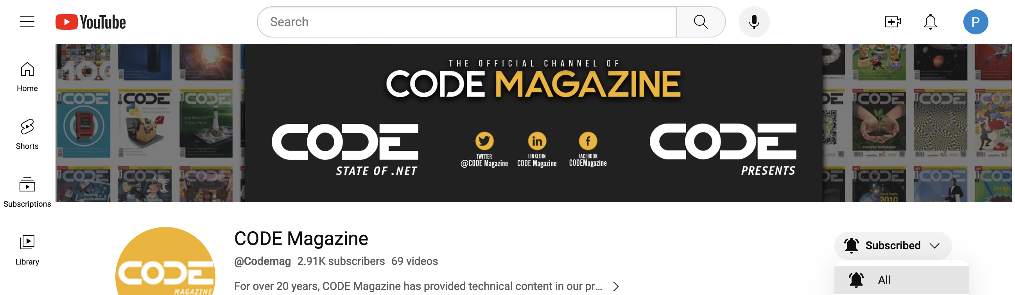
Subscribe and “ring that bell”
to never miss any of our content!
youtube.com/codemag

Slide 18
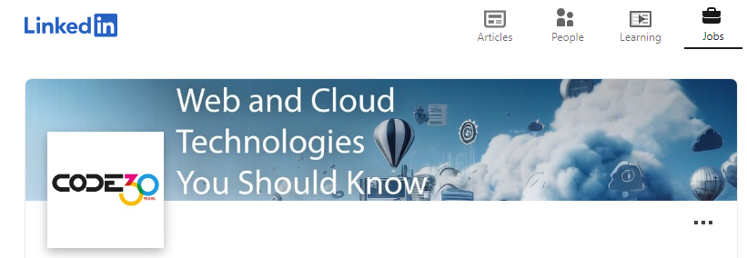

Be the first to know about our webinars, workshops, and live events!
Follow us!
www.linkedin.com/company/code-magazine

Slide 19
Please fill out the survey!

Slide 20
Our Next CODE Presents: Nov 12
AI-Assisted Greenfield Software Development: Building an Academic Management System from Concept to Production
https://codemag.com/event/CP-11-2025

Slide 21
Q&A
Contact us with questions!
CODE Contact
codemag.com
info@codemag.com
facebook.com/codemag
twitter.com/codemagazine
Presenter Contact
myeager@codemag.com

