Slide 1
AI-Assisted Software Development
Green Field Development

Slide 2
New Development Focus
Project Requirements
Instructions
Chat Modes
Agents
Implementation Prompts
Prompt Verification
Notes:
Welcome everyone! Over the next two days, we’ll dive into how Copilot can accelerate software development through structured instructions, custom chat modes, and prompt-driven agent execution.

Slide 3
“AI will not replace humans, but those who use AI will replace those who don’t.”
— Ginni Rometty
Notes:
This quote captures the spirit of my approach to AI for Software Development. Copilot isn’t just a tool — it’s a multiplier.

Slide 4
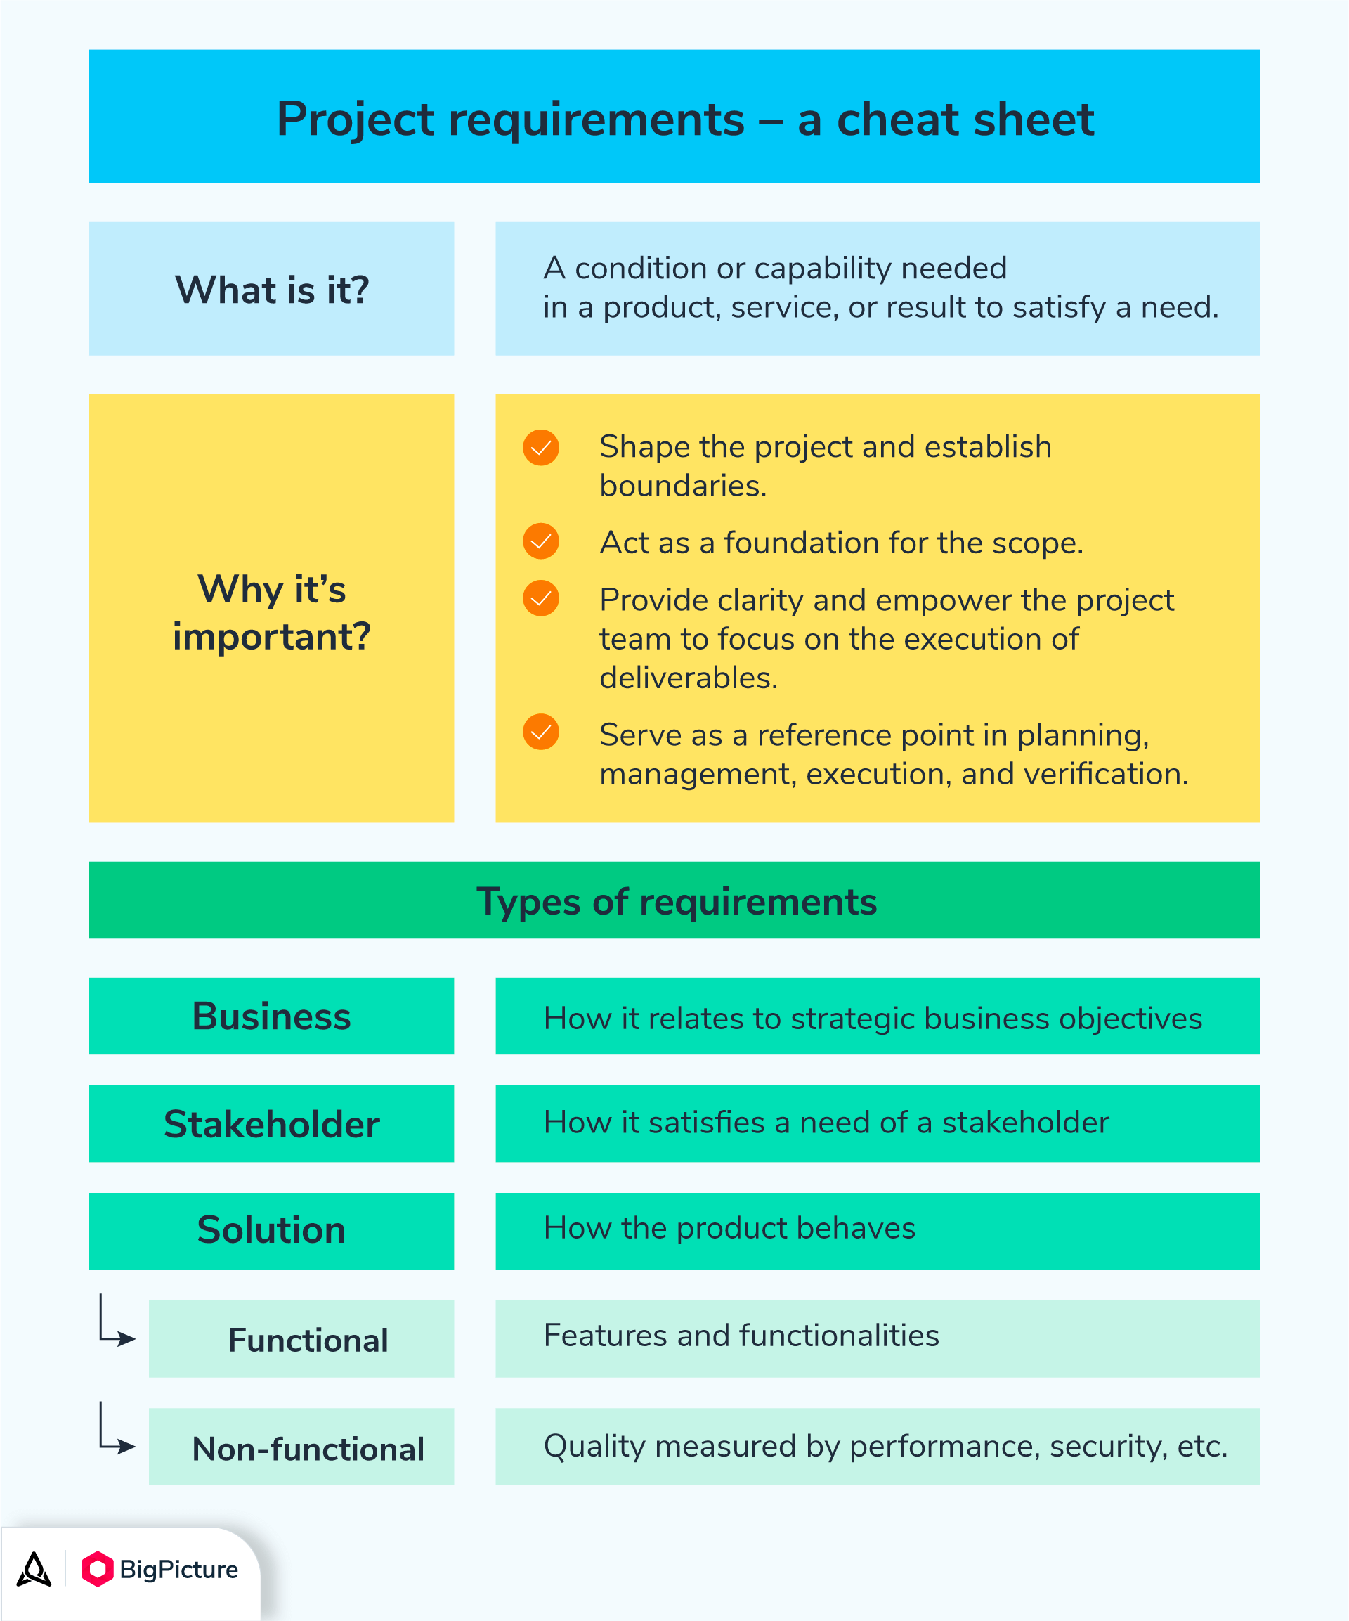
Project Requirements
Key Elements:
  Business Rules
  Workflows
  Tech Stack
  Architecture
Notes:
This presentation is based on an experiment I’ve been conducting over the past several weeks. The experiment is in how far AI can get in creating a production quality application starting with only the business rules that need to be enforced by the app.
Before Copilot can assist meaningfully, we must define the foundational elements of the project. These requirements shape how instructions and agents behave.

Slide 5
Demo #1 – Create Project Requirement Instruction
Objective:
  Generate project requirement instructions manually and with Copilot.
Tasks:
  Create copilot-instructions.md
    Include business rules, workflows, purpose, tech stack, architecture
  Use Copilot to generate instruction files from codebase context
Bonus:
  Review for errors and omissions
  Ask Copilot for updates based on evolving tech
Notes:
This demo builds the instruction foundation. Manual creation ensures clarity; Copilot-assisted generation adds scalability.

Slide 6
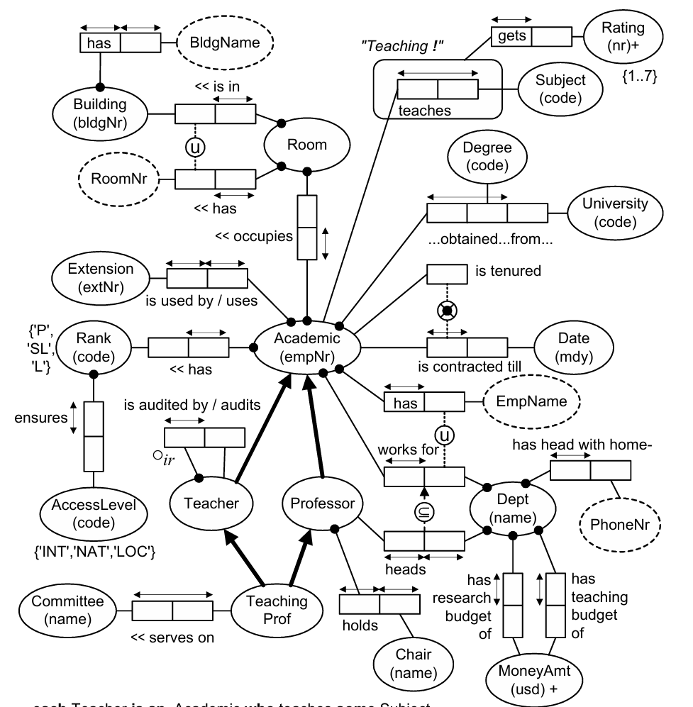
Business Rules as Instructions
A Professor is defined as an Academic holding the rank of 'P'.
A Professor who leads a Department must be employed by that Department.
A Teacher who audits another Teacher cannot be audited by that same Teacher.
A TeachingProfessor holds the roles of both Teacher and Professor.
An Academic’s contract end date is indicated by a Date attribute.
Each Academic has an EmpName.
An Academic must have exactly one EmpName.
Each Academic holds exactly one Rank.
An Academic possesses a Rank.
An Academic is tenured.
An Academic obtains a Degree from a University.
Each Academic occupies a single, unique Room.
An Academic occupies a Room.
An Academic teaches zero or more Subjects.
An Academic uses an Extension.
Each Academic uses exactly one Extension.
Tenured Academics must not have a contract end Date.
An Academic is employed by a Department.
AccessLevel codes include 'LOC', 'INT', or 'NAT'.
An Academic obtains a Degree from at most one University.
Each BldgName is assigned to exactly one Building.
Each BldgNr is assigned to exactly one Building.
A Building has a BldgName.
A Building has a BldgNr.
Each Building has exactly one BldgName.
Each Building has exactly one BldgNr.
A Building contains one or more Rooms.
A Chair has a name.
Each Chair has exactly one name.
A Chair is held by at most one Professor.
A Committee has a name.
Each Committee has exactly one name.
A Committee is served by zero or more TeachingProfessors.
A Degree has a code.
Each Degree has exactly one code.
A Department may have at most one Chair.
A Department has a Chair.
A Department is led by a head who has a home PhoneNr.
Each Department head has exactly one home PhoneNr.
A Department is headed by at most one Professor.
A Department must have a research budget valued in MoneyAmt.
A Department must have a teaching budget valued in MoneyAmt.
Each Academic working for a Department must have a unique EmpName within that Department.
Each empNr is assigned to exactly one Academic.
Each Extension is used by exactly one Academic.
MoneyAmt must be a positive value denominated in US Dollars.
A Professor may head at most one Department.
A Professor heads a Department.
A Professor may hold at most one Chair.
A Professor holds a Chair.
Rank determines AccessLevel.
Each Rank ensures exactly one AccessLevel.
Rank codes include 'P', 'SL', or 'L'.
Rating values range from 1 to 7.
A Room is located in a Building.
Each Room is located in exactly one Building.
A Room is occupied by one or more Academics.
A Subject has a code.
Each Subject has exactly one code.
A Subject may be taught by zero or more Academics.
A Teacher audits another Teacher.
A Teacher is an Academic who teaches one or more Subjects.
A Teacher is audited by another Teacher.
Teaching activities receive a Rating.
TeachingProfessors serve on Committees.
TeachingProfessors may serve on zero or more Committees.
The combination of a Room’s roomNr and its Building is unique.
The relationship indicating that an Academic teaches a Subject is referred to as Teaching.
A University has a code.
Each University has exactly one code.
Notes:
This is an Object Role Model (see ORM.NET) of an academic institution.
ORM models are conceptual, they are not bound to any implementation technologies.
A key benefit for our use is that ORM models are both visual and textual.
A textual ORM model can be rendered as a diagram, and a visual model can be represented as text.
On the left is the visual model and on the right is a portion of the textual representation.
Interesting facts:
A Teacher that audits another Teacher cannot be audited by that Teacher.
A TeachingProfessor is both a Teacher and a Professor.
Academic who is tenured must not have a Date indicating their contract end.

Slide 7
What Are CoPilot Instructions?
Definition:
  Instructions guide Copilot’s behavior and context awareness.
Locations:
  Project-level
  User-level
Notes:
Instructions are the DNA of Copilot’s behavior. They define scope, tone, and capabilities

Slide 8
Demo #2 – Generate Instruction Files
Objective:
Create instruction files manually and with Copilot.
Tasks:
  Create copilot-instructions.md
  Use Copilot to generate contextual instructions
  Review and refine with AI suggestions
Notes:
This reinforces the workflow from earlier but with deeper integration and refinement.

Slide 9
Creating Custom Chat Modes
Components:
  Personas
  Workflows
  Examples
  Agents
  Autonomous Actions
    Agent.json
    Safe vs. Unsafe Commands
Notes:
Chat modes personalize Copilot’s behavior. Think of them as specialized assistants tuned for specific tasks.

Slide 10
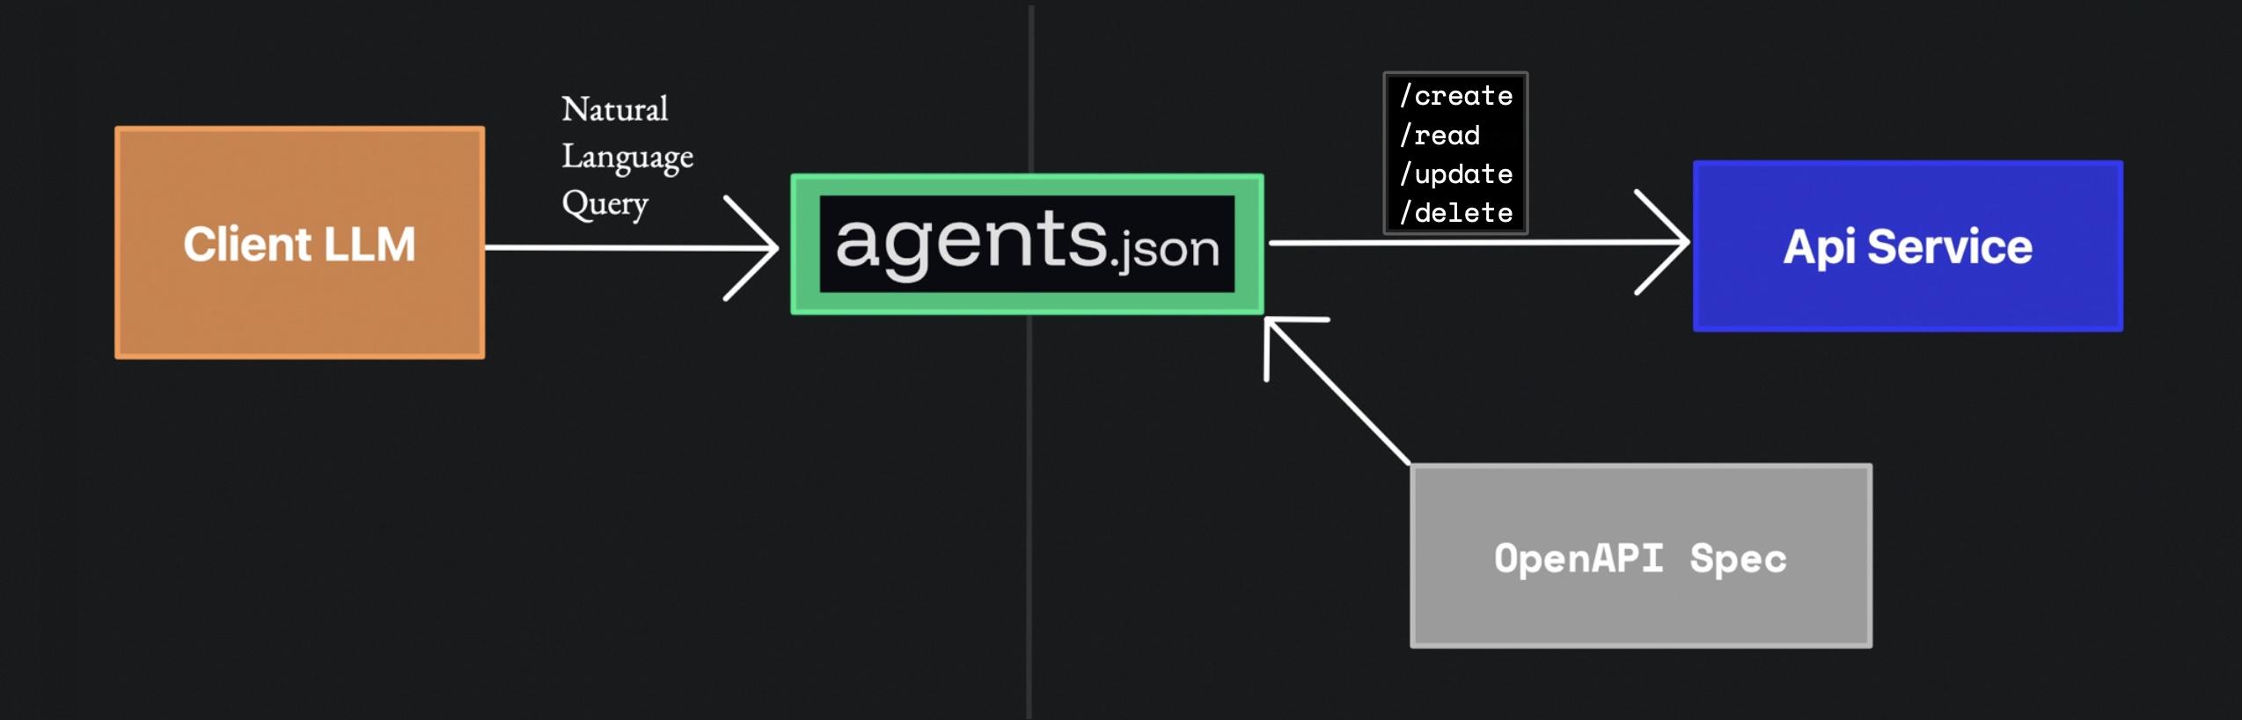
Demo #3 – Creating Custom Chat Modes
Objective:
  Build tailored chat modes for the project.
Tasks:
  Define personas and workflows
  Implement with Copilot assistance
  Create with safe commands
  Test agent execution
Notes:
This is where Copilot becomes truly agentic — executing tasks safely and autonomously.

Slide 11
Implementation Prompts & Verification
Topics:
  Prompt Creation
  Verification Logic
  Ensuring Safe Execution
Notes:
Prompts are the bridge between instructions and action. Verification ensures reliability.

Slide 12
Demo #4 – Executing Prompts
Objective:
  Use prompts to guide agent actions and verify outcomes.
Tasks:
  Review existing prompts
  Execute via chat modes
  Test agent responses
  Verify results
Notes:
This is the final integration step — where everything comes together in a live execution loop.

Slide 13
What About the UI?
Premise: A UI can be derived from a conceptual model just like a database or a class.
Notes:
A conceptual model is a great way of thinking about a UI.
Start with an object in the model. Project what information should be displayed on a page that focused on that object.
ie.
Room
displays a room number
displays a building number
displays a building name
display a collection of academics that occupy that room including (derived by including required facts with an uniqueness contraint on academic)
the EmpName
the Department Name
the Rank code
the ExtNr
Professor
displays the Chair Name the professor holds
display the Dept Name they work for
display a list of Degrees they obtained including
the university code
display a list of subjects they teach, if any, including
the subject code
the rating nr gotten
display the Room Nr and Building Name of the Room they occupy
display their Extension Nr
display their Rank and Access Level code

Slide 14
The “Nice to Have” Dilemma
Enterprise teams often maintain 300–500 items in their product backlog, with some reporting over 1,000+ items depending on project scope and organizational size.
A case study from StackExchange noted a team with 400 backlog items, completing only 5 per sprint (biweekly), leading to severe prioritization challenges and duplication.
According to Ruhani Rabin’s backlog metrics guide, a growing backlog signals that new items are being added faster than they’re completed — often due to over-scoping or unrealistic projections.
The last two-thirds of most backlogs are likely to change or become obsolete before implementation, reinforcing the need for pruning and consolidation.

Slide 15
Tips and Tricks
VS Code Setting: @id:terminal.integrated.focusAfterRun = terminal
Instructions: Before making code changes, file modifications, or system operations describe:
  What I want to change
  Where the changes will be made
  Why the changes are necessary
  How the changes will impact the system
  Ask for permission to proceed with the changes
Instructions: When running automated tests, report the code coverage metrics
Instructions: Separate the instruction into to groups, project specific and generic. For shared instructions see Sharing Instructions with the Team

Slide 16
Tips and Tricks
Prompting: When encountering errors that are possibly due to problems in another tier, ask Copilot to write a prompt that can then be used to trouble shoot the issue on the other tier
Prompting: Poor short-term memory
  I notice that you've made manual edits…
  Be wary of anything "Temporary" as it may not be reverted
  AHA! The debugging code is STILL THERE! It should have been removed earlier, but it wasn’t.
Prompting: Quick Chat
Stop and Continue
Responses: Watch out for rabbit holes

Slide 17
Lessons Learned
Review the code, especially the test automation
Keep, Commit often to keep change sets small
Be a bit more prescriptive about the tech stack
Be clear about the definition of done
  Tests, documentation, diagrams, etc.
  Don’t proceed if there are errors
Define the expected developer workflow
  Work on a development branch
  Test Automation
  Quality Gates
  Merge to main when the app is in a deployable state
Be clear about infrastructure constraints and standards
Verify that no secrets are committed to source

Slide 18
Wrap-Up & Open Q&A
Topics:
  Recap of key learnings
  Open discussion
  Next steps
    https://github.com/johnmillerATcodemag-com/Zeus.People
      Review the instruction files
      Review the prompt files and captured responses
      Review the generated documentation
Notes:
Let’s reflect on what we’ve built: modular, scalable, AI-assisted workflows that are safe, auditable, and powerful.

